Slide 1
MANPOWER NEEDS AT CRAFT, VOCATIONAL AND TECHNICAL LEVELS AND CAPACITY BUILDING IN EDUCATIONAL INSTITUTIONS
FOR OIL AND GAS INDUSTRY
W.K.Wimalsiri & T.A.Piyasiri
University of Moratuwa

Slide 2
OFFSHORE OIL & GAS PRODUCTION SYSTEM
Major Elements
Main Processes
Specialized Techniques
Essential Personnel & Manning Requirement
Safety and Reliability
Training & Competency-Meeting Specialized Manpower

Slide 3
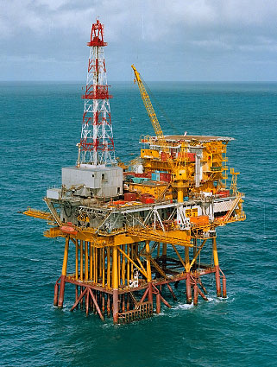
Major Elements
WELLS
WELL PLATFORMS/WELL SERVICING RIGS
FEEDER SUBSEA PIPELINES
PROCESSING PLATFORMS
EXPORT PIPELINES FOR OIL/GAS
TANKERS FOR EVACUATION OF OIL.

Slide 4
Main Processes
Three phases (oil, gas & water) Well fluid is received from the well and subject to
Separation (Oil, Gas and Produced water) & Oil dispatch
Gas Compression & dehydration
Produced Water Conditioning
Sea water processing & injection system
These process will involves the following needs
Fire detection & Suppression system
Power Generation
Well services/Drilling Modules
Water Maker/Utilities/Sewage Treatment
Living Quarters

Slide 5
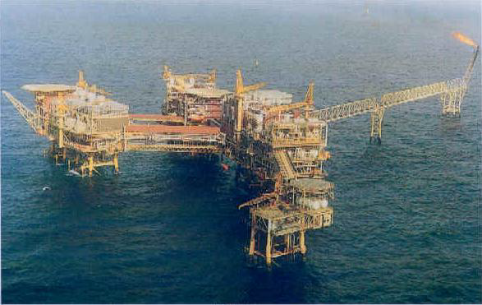
Main Processes
GAS COMPRESSION & DEHYDRATION
SEA WATER TREATMENT AND INJECTION
LIVING QUARTERS
SEPARATION AND CRUDE PUMPING
BRIDGE CONNECTED WELL PLATFORM

Slide 6
Specialized Techniques
Drilling
Dynamic Positioning – Computer controlled positioning of vessels, offshore drilling units etc. against wind and surrounding effects
Underwater Welding and Maintenance
Saturation Diving and Diving Systems- Diving technique that allows divers to reduce the risk of decompression sickness
Extra Safety and Reliability

Slide 7
Essential Personnel-Managerial
MANAGERS:
OFFSHORE INSTALLATION MANAGER
    Ultimate authority making decisions regarding the operation of the platform
PROCESS MANAGER
MAINTENANCE MANAGER
WELL PLATFORM MANAGER
HSE MANAGER
Health, Safety and Environment

Slide 8
Essential Team-Operational Level
TEAMS
•Process control room operators
•Mechanical/Electrical/Instrumentation team
•Static Equipment maintenance team
•Wellhead teams
•Pipeline maintenance team
•Skilled and Unskilled technicians

Slide 9
Essential Personnel-Operational Level
Offshore Operations Engineer (OOE) -is the senior technical authority on the platform
Operations coordinator - for managing crew changes
Dynamic Positioning Operator, navigation, ship or vessel maneuvering, station keeping, fire and gas systems operations in the event of incident
2nd Mate & 3rd Mate ‐Meets manning requirements of flag state, operates Fast Rescue craft, cargo ops, fire team leader.
Ballast Control Operator _ also fire and gas systems operator

Slide 10
Essential Personnel-Operational Level
Crane operators - Operate the cranes for lifting cargo around the platform and between boats
Scaffolders - To rig up scaffolding for when it is required for workers to work at height
Coxswains -Maintaining the lifeboats and manning them if necessary
Control room operators ‐Especially for Production platforms
Production technicians -For running the production plant
Helicopter Pilot(s) -The helicopter flight crew transports workers to other platforms or to shore on crew changes
Maintenance technicians (instrument ,electrical, mechanical

Slide 11
Manning Requirements
Technologists
Technicians
Craftsmen

Slide 12
Scope & Responsibilities of Technologist
Research
Administration of Relevant Department
Production Planning & Scheduling
Optimization of Production
Improves efficiency and Effectiveness
Ensure Safety and Reliability
Economic Analysis

Slide 13
Scope and Responsibility of Technicians
Preventive & Failure Maintenance and Operation of Machinery and Equipment
Maintains all Instrumentation Controlling the Process and Utility systems, Fire & Gas protection / detection
Emergency Shutdown in a Safe and Competent Manner
Ensure Production Targets
Sample testing, Product Quality
Ensure Health and Safety During Operation

Slide 14
Scope and Responsibility of Craftman
Installs, maintains and troubleshoots equipment used to control and monitor wells, pipelines, compressors, etc. remotely
Installs, maintains and troubleshoots electrical/electronic equipment used in gas production, processing and/or transportation
Performs testing, troubleshooting, maintenance and repairs on the electronic and electro-mechanical equipment used to monitor and control the mixing, metering and pumping equipment

Slide 15
Level of Competency of Technologist
Degree in
  Mechanical Engineering with Instrumentation and Control
  Electrical/Electronic Engineering
  Chemical & Process Engineering with Oil and Gas Exploration
  Marine Engineering
  Manufacturing Engineering
  Petroleum Engineering
  Industrial Safety and Environment Technology
  And sufficient relevant industrial exposure

Slide 16
Level of Competency of Technician
Diploma in
  Mechanical Engineering with Instrumentation and Control
  Electrical/Electronic Engineering
  Chemical Engineering with Oil and Gas Exploration
  Marine Engineering
  Manufacturing Engineering
  Petroleum Engineering
  Industrial Safety and Environment Technology
  Welding Technology
  And sufficient industrial exposure

Slide 17
Level of Competency of Craftsman
NVQ in
  Mechanical Technology
  Electrical Technology
  Welding and Fabrication technology
  Manufacturing
  Pipeline Maintenance
  Pneumatic
  Hydraulic etc.

Slide 18
National Vocational Qualification (NVQ) Levels
 |  |  |  |  | NVQ Level 7 | Involve with Design and innovation
 |  |  |  | NVQ Level 6 | Manage others
 |  |  | NVQ Level 5 | Supervise others
 |  | NVQ Level 4 | Work independently
 | NVQ Level 3 | Work under some supervision
NVQ Level 2 | Work under Supervision
Core entry/basic skills (NVQ Level 1)
Deg
Diplomas
Certificates

Slide 19
Operational Framework
University of Vocational Technology
(Degree Level) NVQ 7
Professional
Qualifications
Existing middle level qualifications
Schools
Colleges of Technology - One in each Province (Total 9)
(Diploma Level) NVQ 5 & 6
Industry
Technical Education and Vocational Training Institutes
(Certificate Level) NVQ 1 - 4

Slide 20
Relevant NVQ Courses
Welder
Machinist
Electrician
Industrial Electronics Technician
Pneumatic Technician
Industrial Plumber
Boiler Operator
Ref. and Air Technician
ICT Technician
Welding Technology
Production Technology
Mechatronics
Telecommunication Technology
Information Technology with specializations
Crafts Level
Diploma Level

Slide 21
Safety and Reliability
Comply with Classification Rules and Standards
Operational Safety
Personal Safety

Slide 22
Meeting Specialized Manpower Requirements
Provide Specialized Training for Existing
Technologists, Technicians and Craftsmen qualified and experienced in relevant areas.
Upgrading existing courses in Universities and Technical colleges
Commence new specialized courses relevant to identified fields in Universities and Technical and Vocational Institutes.
Short/Medium term Strategy
Long Term Strategy

Slide 23

Thank you

