Slide 1
The Petroleum Industry: Global Perspectives and National Prospects in Sri Lanka
A random wander through strategies for success in the Global E&P Village
Cairn Lanka, 2013 UGC-PRDS Developing E&P Competency, Geo-Workshop, Negombo, Sri Lanka, January 2013
Stuart Burley
stuart.burley@cairnindia.com
Head of Geosciences, Cairn India
Professor of Petroleum Geology at the University of Keele, UK

Slide 2


ACKNOWLEDGEMENTS
Prof Ranjith Senaratne, Chairman of the Organising Committee Prof Gamini Samaranayake, Chairman UGC
Gayani Wickramarachchi, Secretary to the Organising Committee
The Petroleum Resources Development Secretariate (PRDS)
and to you all for your kind attention
Cairn Lanka for permission to attend and contribute

Slide 3
The Petroleum industry: Global Perspectives
Defining characteristics
Cairn Lanka, 2013 UGC-PRDS Developing E&P Competency, Geo-Workshop, Negombo, Sri Lanka, January 2013
Presentation theme
Hydrocarbons are the major global energy source for at least the next generation
We have passed conventional ‘peak oil’, gas is the hydrocarbon of the future, unconventionals exceed conventionals by order(s) of magnitude
E&P is ‘high tech’ – the rate of change in G&G+RE is exponential – in parallel with the explosion in data
Currently little or no government funding for E&P research - funding for E&P innovation will rely almost exclusively on the E&P industry
Effective transfer of technology takes time, effort, planning, organisation and people
Industry needs to work closer with R&D organisations to get better at transferring technology and skills
How independent E&P companies access and apply technology, with examples, but not being prescriptive, nor critical
What technologies ?

Slide 4
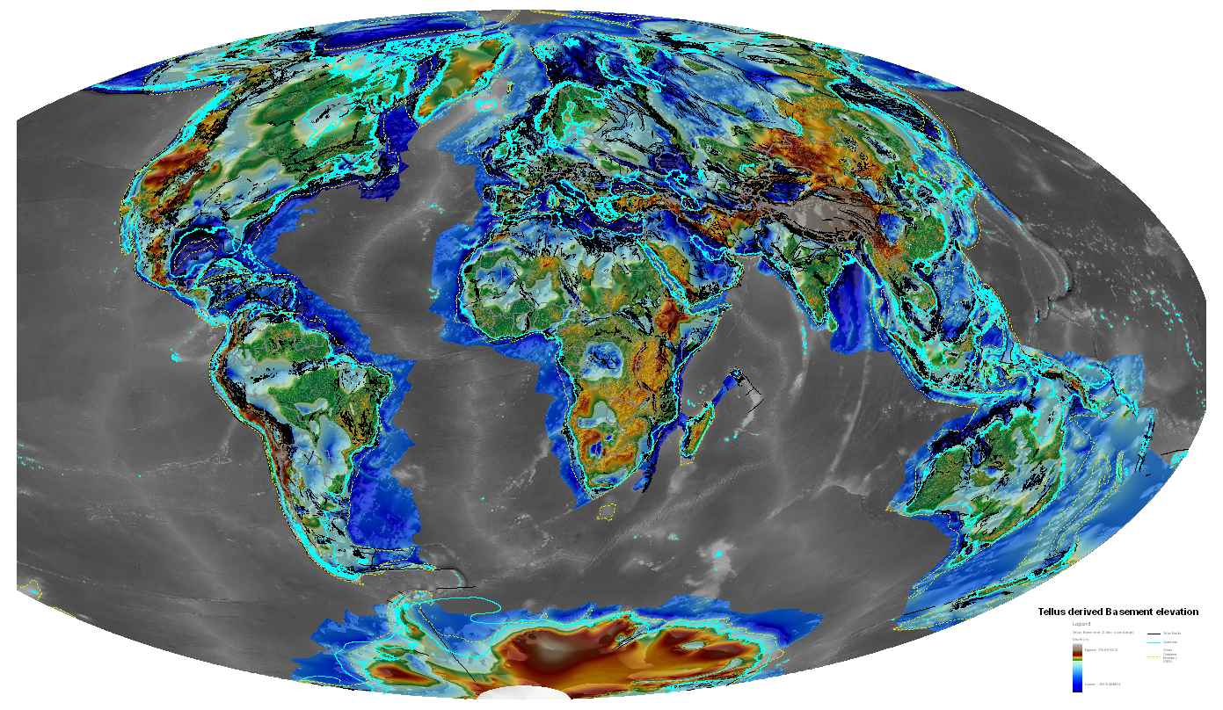
The Petroleum industry: the future is here now
Technology, innovation and business…where would you like to go ?
Cairn Lanka, 2013 UGC-PRDS Developing E&P Competency, Geo-Workshop, Negombo, Sri Lanka, January 2013
Global depth to top basement
There is no shortage of technology and data in the E&P world, and collaboration has never been easier……
We live in the age of the Global Village…….you can go anywhere, choose your partner and destination

Slide 5
Context 1: Dominance of hydrocarbons for energy
Extending peak production, but we have passed peak finding
Cairn Lanka, 2013 UGC-PRDS Developing E&P Competency, Geo-Workshop, Negombo, Sri Lanka, January 2013
Total hydrocarbon production, ever
Conventional oil and gas production
Intent
Source : Colin Campbell PESGB Lecture 2008
Explosive use of hydrocarbons through the late 20th Century
Hydrocarbons are a finite resource, we are producing more than we find
At or close to peak production now
Technology extends the period of peak production…..
And coming over the horizon is global warming…….

Slide 6
Context 2: Demand for hydrocarbons
Growth in fuel demand: 2000-2020
Cairn Lanka, 2013 UGC-PRDS Developing E&P Competency, Geo-Workshop, Negombo, Sri Lanka, January 2013
Quadrillion
Btu
World Energy Consumption
Fuel Demand Growth pa (%)
4
250
Oil
3
200
Gas
2
150
Coal
1
100
0
50
Renewables
Gas
Green
Oil
Coal
Nuclear
Nuclear
0
Growth
1970
1980
1990
2000
2010
2020
Oil 2.0%
Demand for hydrocarbons predicted to grow
Growth equates to 120Gboe and 800TCF by 2050
Hydrocarbon demand outstrips other energy sources
At least for another generation – next 50 years
Source : IEA Energy Outlook - April 2010
Gas 3.4%
Coal 1.2%
Renewables 2.2%
Nuclear 0.3%

Slide 7
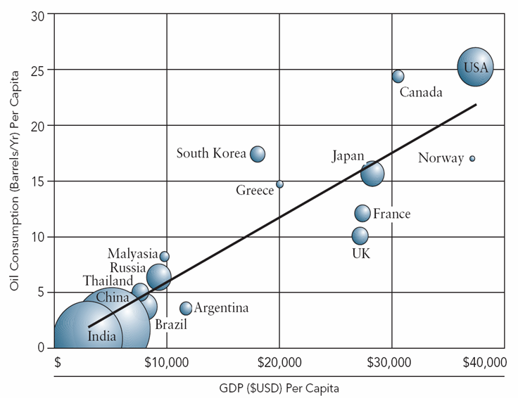
Context 3: Demand for Hydrocarbons
Oil Consumption per Capita vs. per Capita GDP
Cairn Lanka, 2013 UGC-PRDS Developing E&P Competency, Geo-Workshop, Negombo, Sri Lanka, January 2013
Countries consume more oil as they industrialise – expansion then plateau

Slide 8
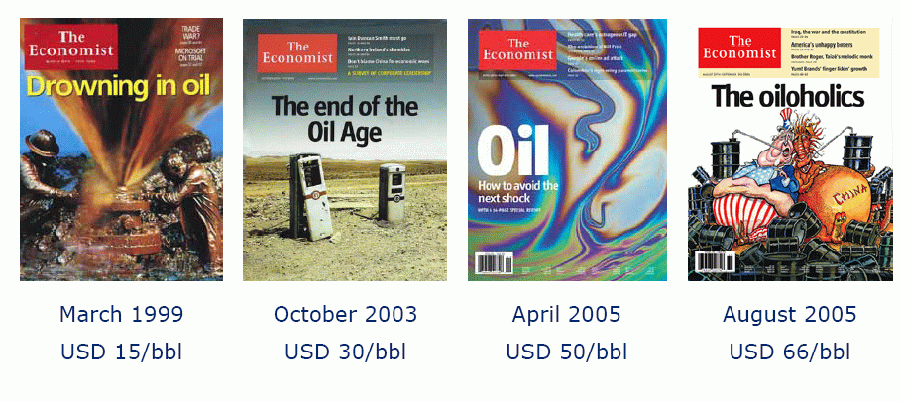
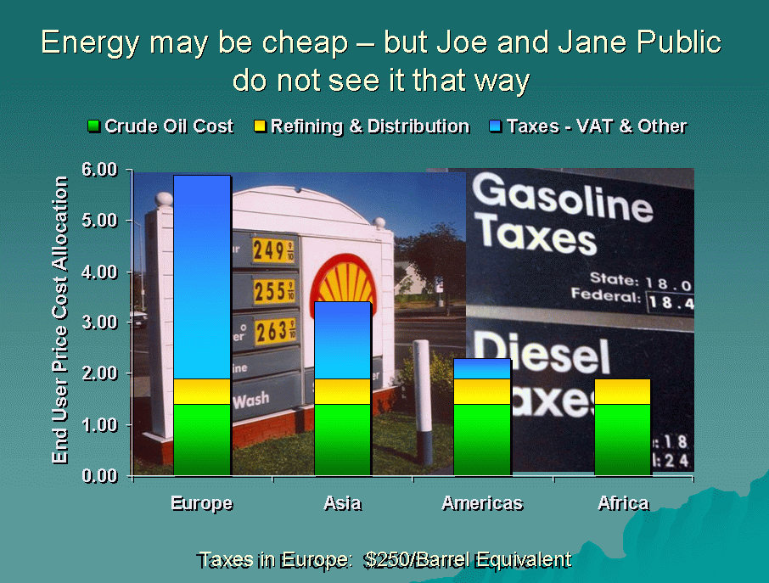
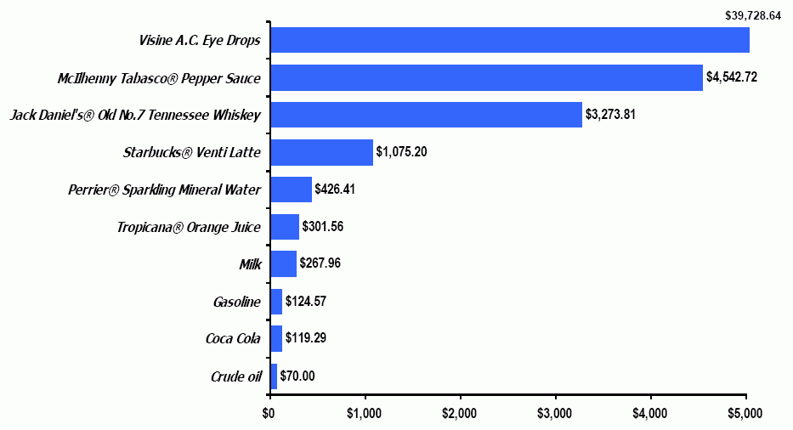
Context 4: Public Perception of the E&P industry
There is poor public understanding
Cairn Lanka, 2013 UGC-PRDS Developing E&P Competency, Geo-Workshop, Negombo, Sri Lanka, January 2013
Public information is short-termist and often misrepresented
Oil is still cheap, even at $100 per barrel
Source : J S Herold
Price comparison per 42 gallon barrel

Slide 9
So, how much oil have we got and where is it all?
Global Proven Reserves
Cairn Lanka, 2013 UGC-PRDS Developing E&P Competency, Geo-Workshop, Negombo, Sri Lanka, January 2013
We have good estimates of global conventional resources
Overall low proven reserves for Asia- Pacific region
Sri Lanka is a frontier province with little activity and at a nascent stage
These figures do not include unconventional hydrocarbon resources
Source: BP Statistical Review of World Energy, June 2008

Slide 10
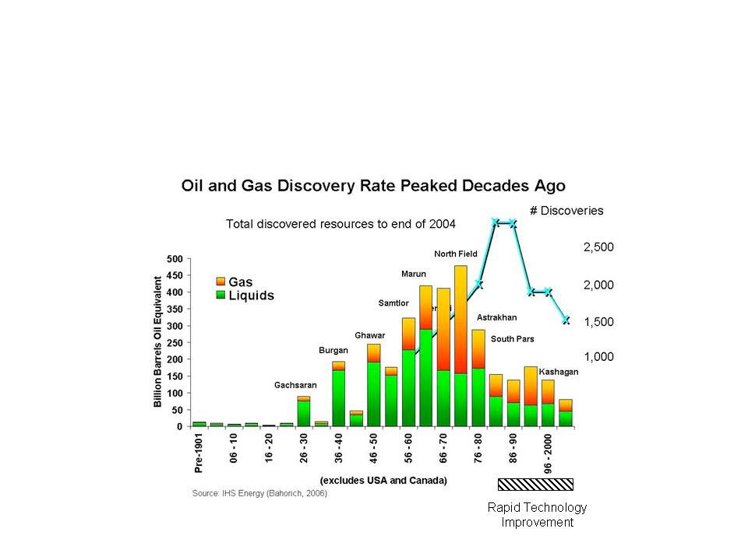
We have reached ‘Peak Oil’
Conventional oil & gas discovery rate peaked decades ago....
Cairn Lanka, 2013 UGC-PRDS Developing E&P Competency, Geo-Workshop, Negombo, Sri Lanka, January 2013
This is a mature business
Technology is now a key driver of finding more hydrocarbons
Deeper, tighter, smaller, harder……………..

Slide 11
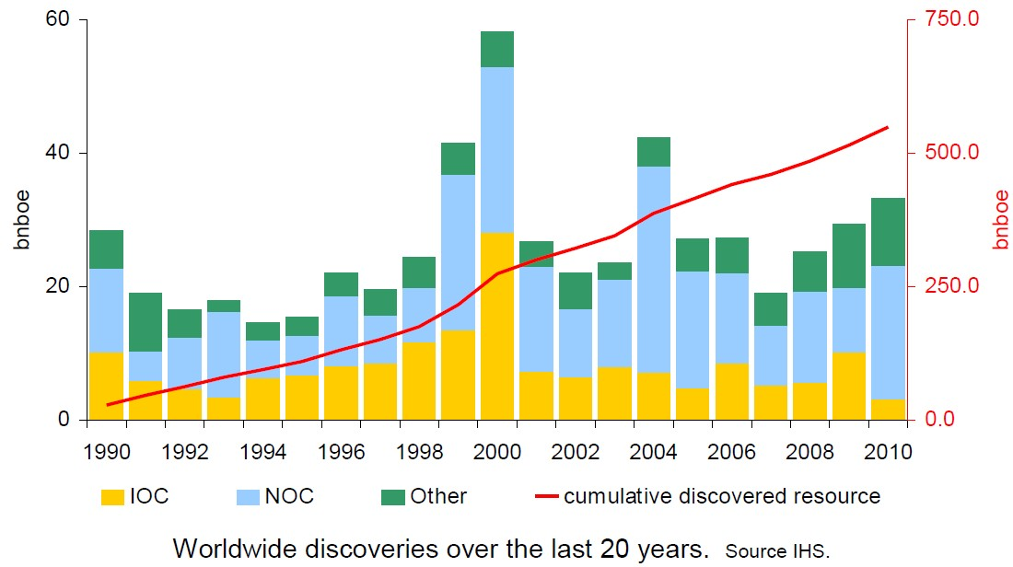
We have reached ‘Peak Oil’
Most discoveries since 1990 dominated by National Oil Companies....
Cairn Lanka, 2013 UGC-PRDS Developing E&P Competency, Geo-Workshop, Negombo, Sri Lanka, January 2013
This is simply protecting national interests……..through access to acreage

Slide 12
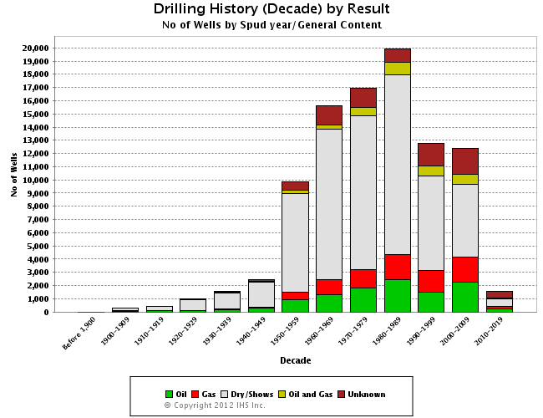
Exploration is a risky business
Most wells drilled do not find any oil or gas !
Cairn Lanka, 2013 UGC-PRDS Developing E&P Competency, Geo-Workshop, Negombo, Sri Lanka, January 2013
2012-2019/?
Oil/Gas well
Dry well
Unknown
The majority of wells (about 80%) are dry (unsuccessful) – 1 in 5 success rate
Chance of success is much lower in frontier areas

Slide 13
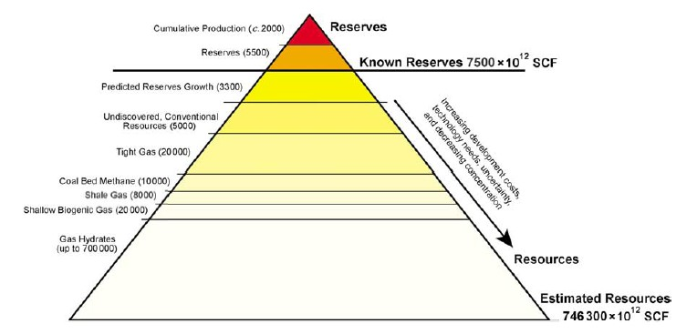

The future is here now – the rise of unconventionals
Yet to find assessments ?
Cairn Lanka, 2013 UGC-PRDS Developing E&P Competency, Geo-Workshop, Negombo, Sri Lanka, January 2013
Current state of E&P play:
246 global basins
76 Basins studied using full play analysis
56 Basins for Unconventional Gas
23 Basins for Coal Bed Methane
“Global” review of Heavy Oil
“Global” review of Light Tight Oil
The stone age did not end because the World ran out of stones
Overlay of economics, and sustainability on Yet to Find volumes stronger than ever before
Unconventional gas (and oil) will change the World HC map
Impact

Slide 14
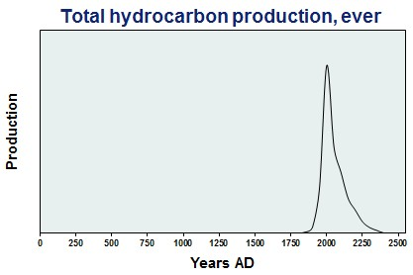
The future is here now – the oil age will not last
What global issues will drive new technology ?
Cairn Lanka, 2013 UGC-PRDS Developing E&P Competency, Geo-Workshop, Negombo, Sri Lanka, January 2013
Likelihood of happening
New Coal resources
Global Carbon Emission Trading
Unconventional HCs
Solar
Biofuels
Gas to liquids
Hydrogen Economy
GLOBAL WARMING
L O O M I N G
Combined Heat & Power in homes
Wind & Wave Power
Car Fuel cells
Much more gas found
Gas market liberalisation
Major New Nuclear Programme
Cold Fusion
Impact
Impact
Alternative energy sources will become available, eventually
Some technology available, implementation slow, depends on oil price…..
Global warming will drive a low carbon energy economy
Source : Roger Rainbow, Energy in 2050, Global Energy December 2010

Slide 15

Cairn Lanka, 2013 UGC-PRDS Developing E&P Competency, Geo-Workshop, Negombo, Sri Lanka, January 2013
You are the best resource we have
Business, technology and innovation…are nothing without people
PEOPLE
BUSINESS
TECHNOLOGY
The creativity of people is the key to innovation and business success……

Slide 16
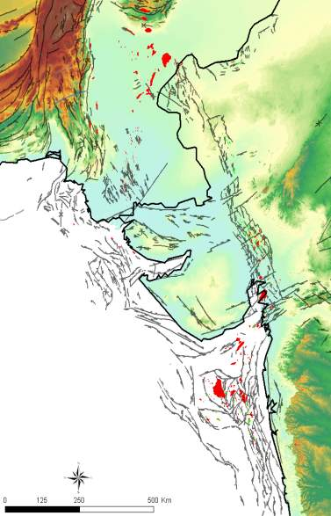
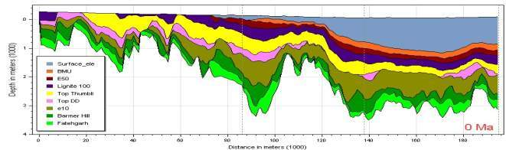
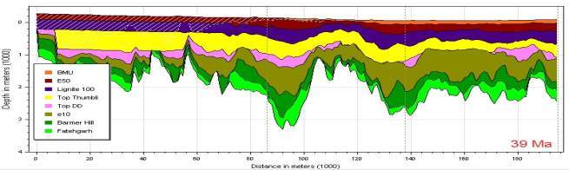

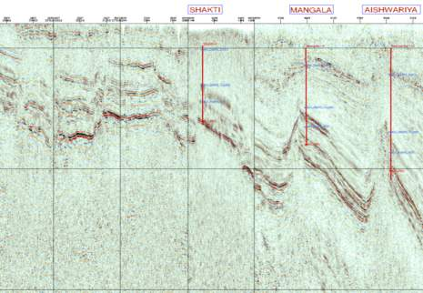
Cairn Lanka, 2013 UGC-PRDS Developing E&P Competency, Geo-Workshop, Negombo, Sri Lanka, January 2013
An example of exploration creativity
Innovative thinking found oil where none was thought to be present
km
0
1.6
Would you drill one of these structures…..?

Slide 17
Why do Companies invest in and use Technology ?
Competitive advantage to reduce risk or costs
Cairn Lanka, 2013 UGC-PRDS Developing E&P Competency, Geo-Workshop, Negombo, Sri Lanka, January 2013
Oil companies aim to make profits………
Total Profit = unit PBIT X volume produced
Technology must therefore either :
Increase unit revenue (oil vs gas, in the right place, quality of product, market) or
Decrease cost base (increase exploration success; better, faster well planning, produce more)
Average figures for 2010
$85
Unit product price
Profit before interest and tax = UPP-Cost Base
Cost base range $15-25, average $17
Share Holder Value
Technology Impact
$8
Operating expenditure
Fewer wells, better wells, faster production
Cost Base
$6
Depreciation, depletion and amoritisation = product/proven reserves
Maximise reserves
$3
Exploration expense
well write-off, G&G department costs, seismic surveys
Increase Chance of Success
Simultaneous growth and improved returns
Link technology with your business…..technology to business mapping

Slide 18
What has happened to our industry ?
Innovation has moved from oil companies to niche service providers
Cairn Lanka, 2013 UGC-PRDS Developing E&P Competency, Geo-Workshop, Negombo, Sri Lanka, January 2013
Oil Company R&D Headcount
Oil Company R&D Investment
‘Rationalisation’
Investment linked
to turnover
Research Centres closed on a global scale through 1990s
R&D and technical staff ‘outsourced’ to specialist consultancies
R&D investment now typically linked to business turnover
Typical industry range 0.5 – 1% of turnover; truly creative companies much higher
R&D investment commonly driven by asset needs not corporate aspiration
The new technology creators…..universities……service providers & consultancies

Slide 19
Technology Positioning : The Funnel Concept
Each oil company has a different approach and positioning
Cairn Lanka, 2013 UGC-PRDS Developing E&P Competency, Geo-Workshop, Negombo, Sri Lanka, January 2013
Typical Oil Company Spend Profile
Technology
Technology
Generic
Technology Challenges
Watch
Partnering
Problem Solving Case Studies
Generic
Technology
Technology
Technology
Problem Solving
IMPLEMENTATION
Watch
Partnering
Challenges
Case Studies
IMPLEMENTATION
Demonstration
Demonstration
Application
Access
Access
Access
through
Partnership
(JIPs)
Development
Development
Fastest Follower
Development
Research
Strategic Procurer
Research
Research
Fastest Implementer
First Developer
First Inventor
Technology application not technology per se is the critical success factor

Slide 20
The future is here now
The explosion of subsurface data – type and volumes……
Cairn Lanka, 2013 UGC-PRDS Developing E&P Competency, Geo-Workshop, Negombo, Sri Lanka, January 2013
enormous proliferation in data
4D
Many Terabytes
Computing Power
3D
S
t
o
c
h
a
s
t
i
c
D
e
t
e
r
m
i
n
i
s
t
i
c
IT Power
S
t
o
c
h
a
s
t
i
c
2D
D
e
t
e
r
m
i
n
i
s
t
i
c
1D
S
t
o
c
h
a
s
t
i
c
D
e
t
e
r
m
i
n
i
s
t
i
c
1960s
1970s
1980s
1990s
2000s
evolution from deterministic to probabilistic approach
powered by explosive growth in computing power
4D visualisation enabled by new software and computing power
Predictive capability from complex algorithms and data
You must control your data – invest in a national data repository
Time

Slide 21
Cairn Lanka, 2013 UGC-PRDS Developing E&P Competency, Geo-Workshop, Negombo, Sri Lanka, January 2013
Technology in Exploration and Production
Technology is an enabler………access a niche where you specialise
Difficult rocks and fluids
“Easy oil and gas”
Tight gas
Gas Shales
Strat traps offshore
Oil Shales
Onshore
Small fields
Offshore
Tight oil
Strat traps onshore
Deep water
HPHT
Oil Sands
Difficult environment
Onshore Arctic
Ultra- Deep water
Remote offshore gas (FLNG)
Border issues
Continental Interiors
Large Igneous Provinces
Offshore Arctic
Offshore Methane Hydrates
Technology helps ! (1) choose strategy, (2) enable the plays..... sometimes both

Slide 22
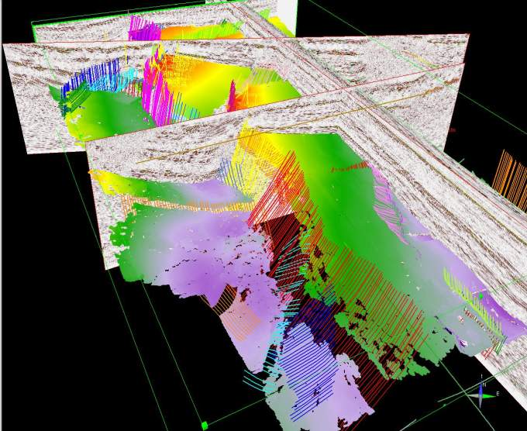
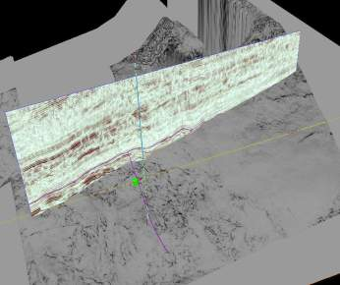
Improved Seismic Interpretation Techniques
Working in 3D – thinking and interpreting at the basin scale
Cairn Lanka, 2013 UGC-PRDS Developing E&P Competency, Geo-Workshop, Negombo, Sri Lanka, January 2013
3D interpretation
    Structure and horizons
    Attributes and AVO
    Coherency
    Output to basin models
    True multi-disciplinary asset teams
Seismic – the Subsurface ‘Hubble’

Slide 23
How do we reduce exploration risk ?
Modelling the subsurface……in 4D, real time and predictive
Cairn Lanka, 2013 UGC-PRDS Developing E&P Competency, Geo-Workshop, Negombo, Sri Lanka, January 2013
gas saturations in Jurassic carrier leaking to Palaeocene carrier
understanding of hydrocarbon migration and fill history

Slide 24
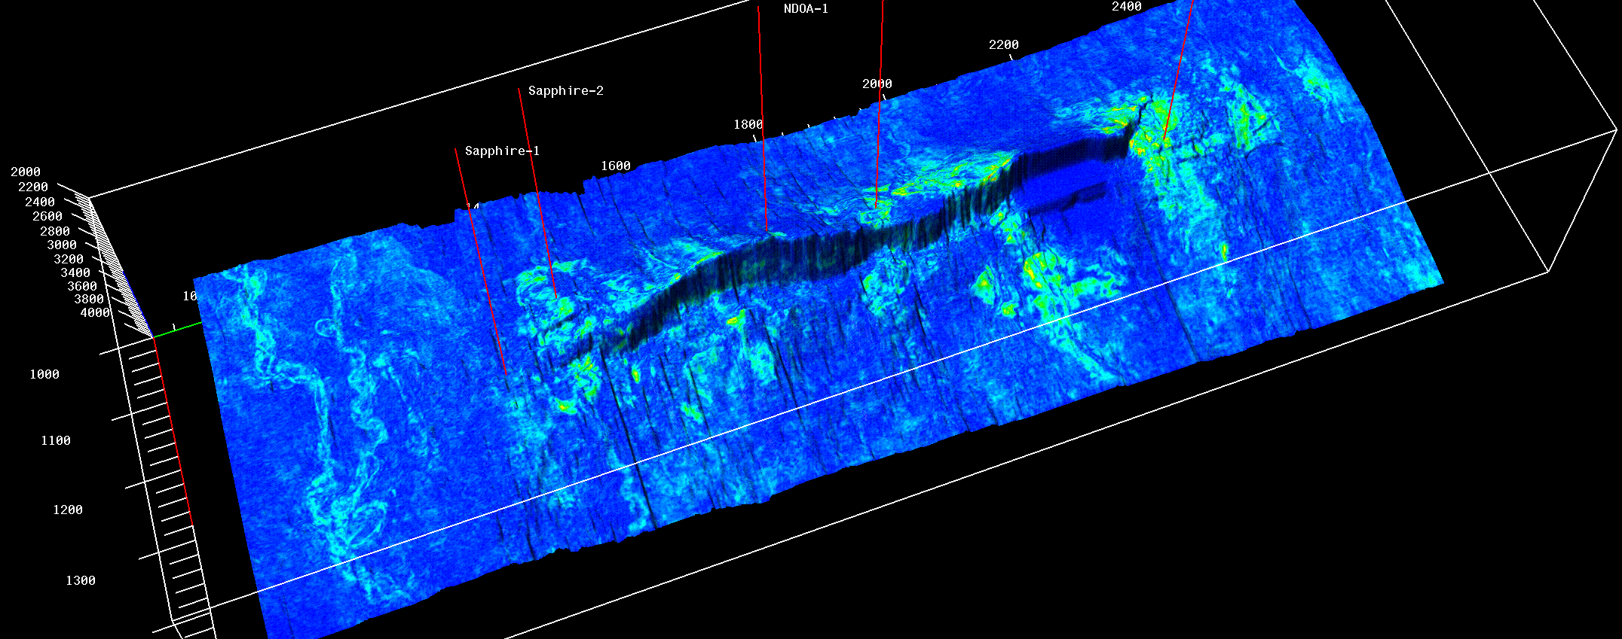
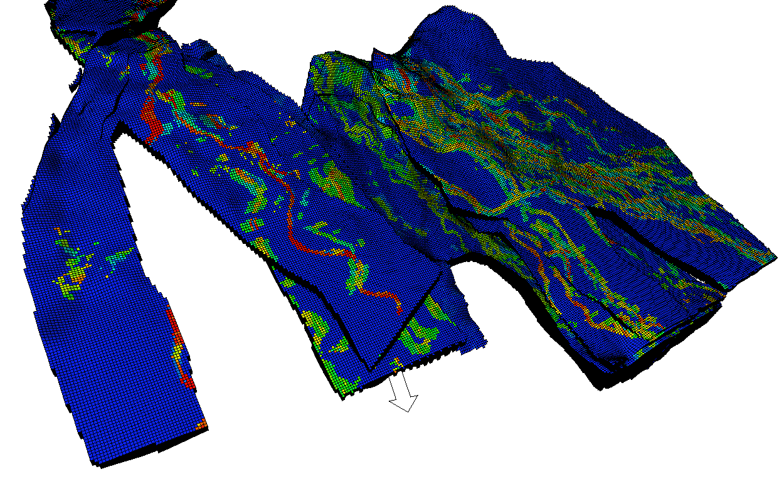
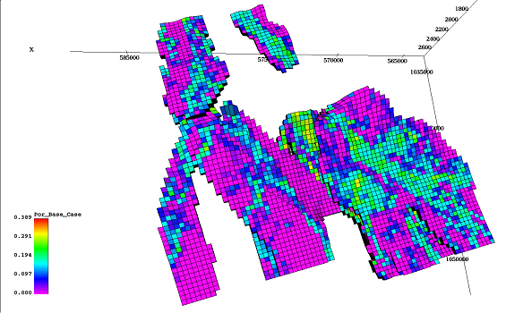
Managing our business – data integration
Technology aids integration
Cairn Lanka, 2013 UGC-PRDS Developing E&P Competency, Geo-Workshop, Negombo, Sri Lanka, January 2013
Seismic to simulator – people make models with data

Slide 25
Growing our business – enabling technologies
What will make a difference ?
Cairn Lanka, 2013 UGC-PRDS Developing E&P Competency, Geo-Workshop, Negombo, Sri Lanka, January 2013
Computing / IT
Computational power
Data vs information
Data/Information Management
Modelling
Remote operations
Robotics, automation
Materials
Sensors - acoustic, optical
Nano-scale technologies
Metallurgy- drilling, facilities, pipelines
Analysis
Analytical techniques - rocks and fluids
Communications
Earth Systems
Event prediction
Tectonics
“Google Earth”
Geo-mechanics
Fluids, pressures and fractures
Geochemistry
Remote sensing and detection
“Hydrocarbon Forensics”
Geophysics
Land seismic quality
Imaging
Reservoir inversion
Gradiometry and CSEM

Slide 26
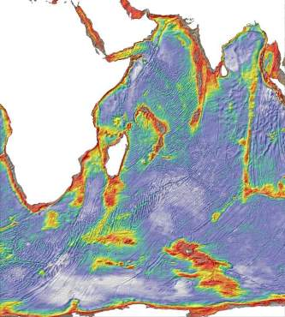
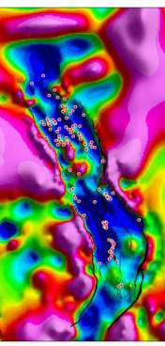
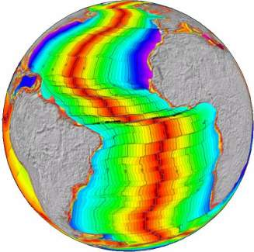
Data – the key to exploration success
Satellites and computing power have made data global…….
Cairn Lanka, 2013 UGC-PRDS Developing E&P Competency, Geo-Workshop, Negombo, Sri Lanka, January 2013
No longer the domain of the super majors
Make sure you have a data repository and control it

Slide 27
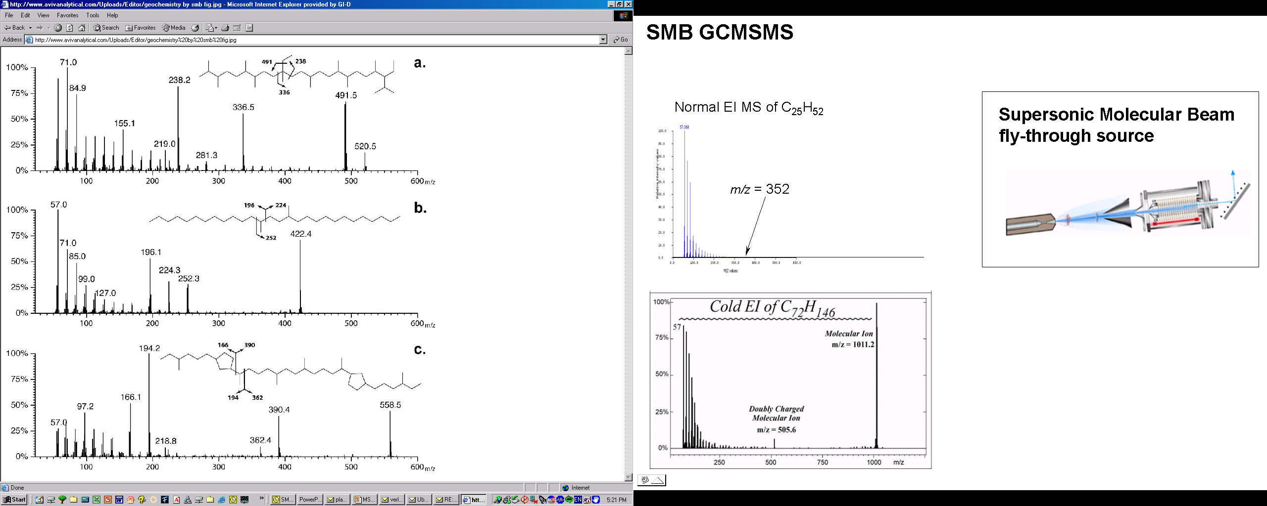
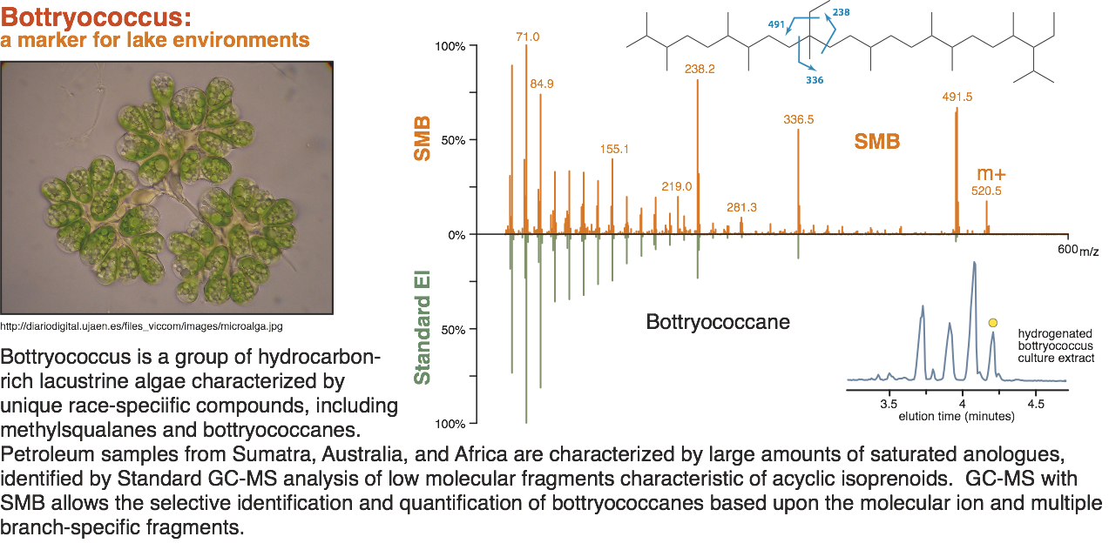
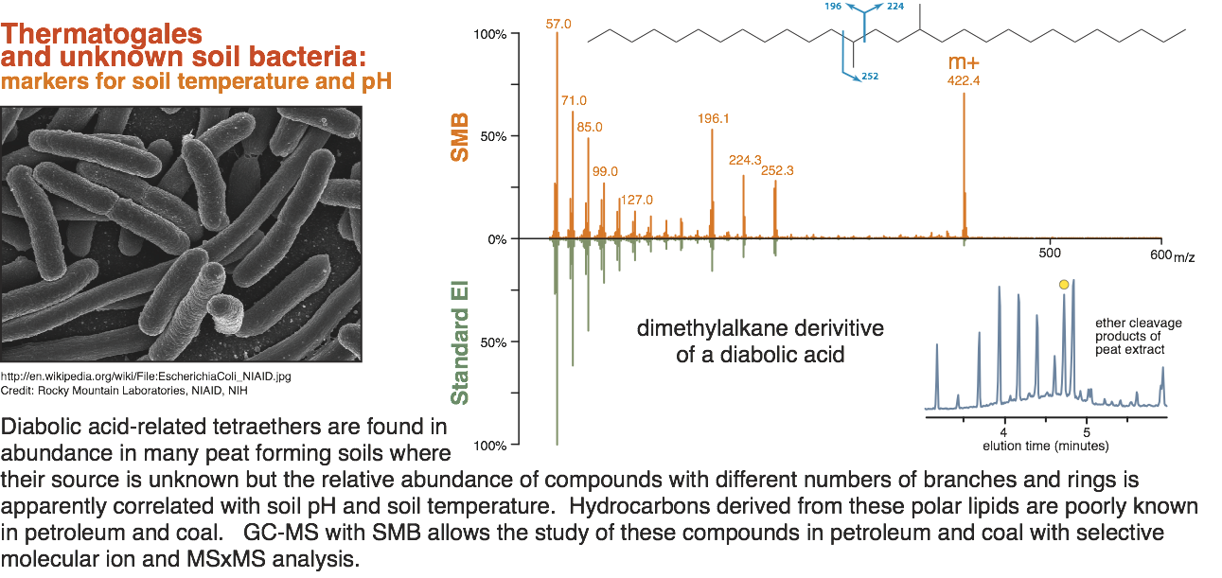
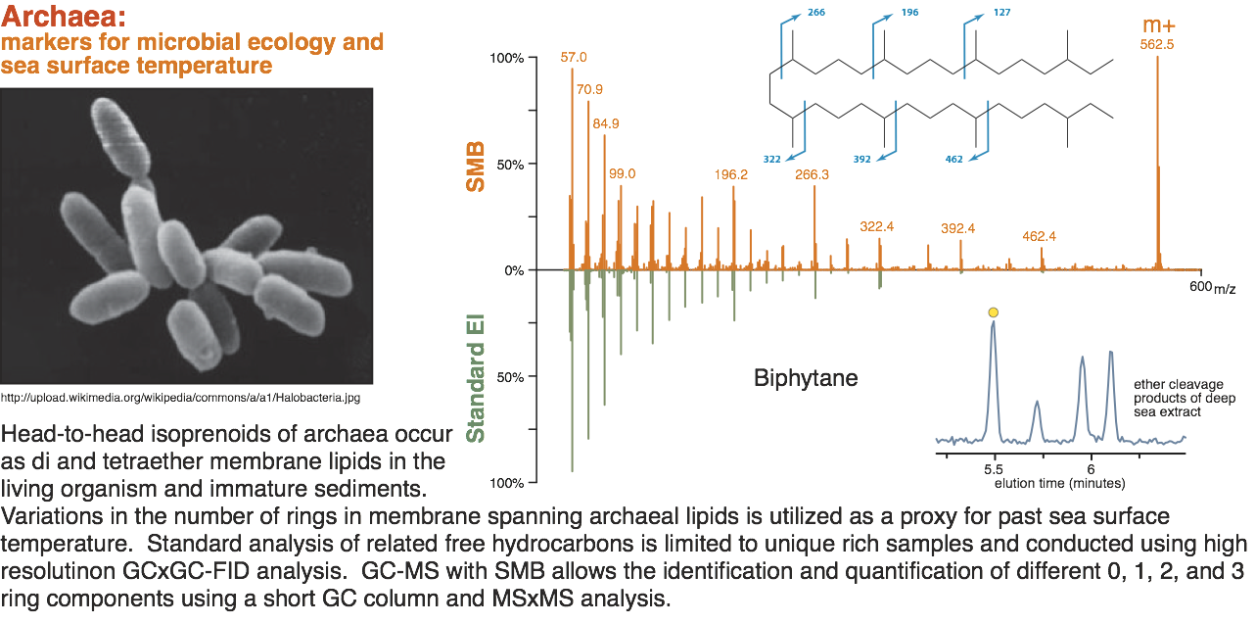
Geochemistry to palaeo-ecology - Biomarkers
Exploration at the molecular scale…….
Cairn Lanka, 2013 UGC-PRDS Developing E&P Competency, Geo-Workshop, Negombo, Sri Lanka, January 2013

Slide 28
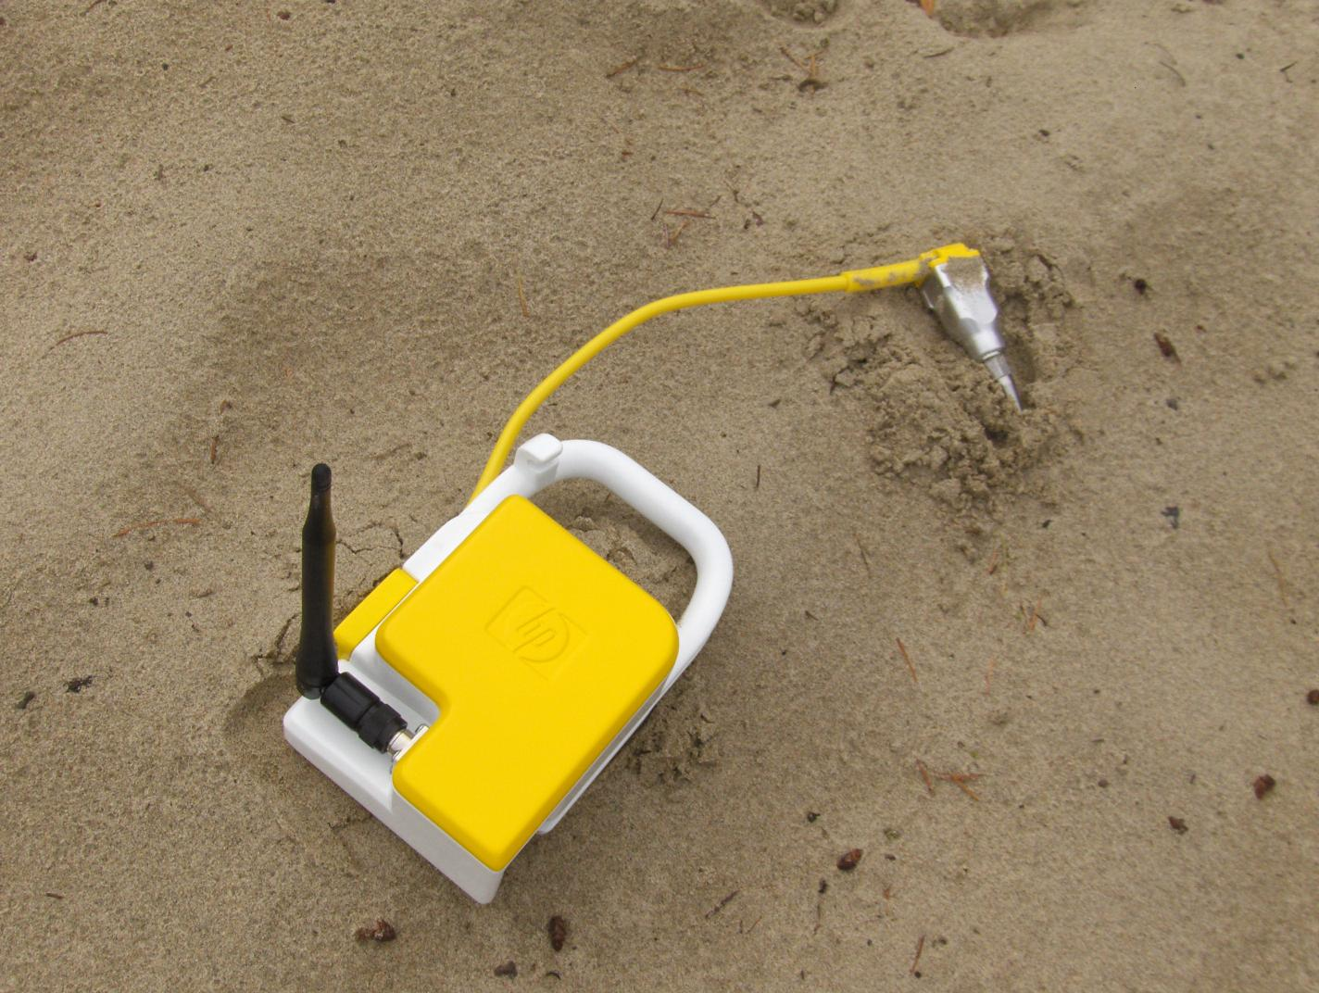

Growing our business – enabling technologies
What will make a difference ? Data acquisition………
Cairn Lanka, 2013 UGC-PRDS Developing E&P Competency, Geo-Workshop, Negombo, Sri Lanka, January 2013
Million Channel Sensor Network (MCSN)
Opportunity for land seismic
    Decrease the unit cost and survey time by a factor of two
    Increase the S/N ratio by a factor three
Different concepts pursued using PGS and HP sensor technologies
  Optical system requiring no power at nodes, using proven PGS’ OBC technology
  Wireless system using low power, low weight, full frequency range MEMS sensors
Low cost onshore high density large bandwidth (semi) permanent systems
Source: Pierre Baliguet, CTO Sercel
1,000,000
2015
100,000
10,000
1,000
100
10

Slide 29
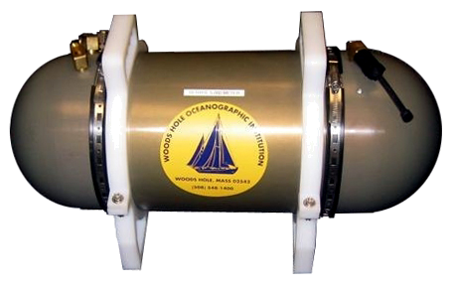
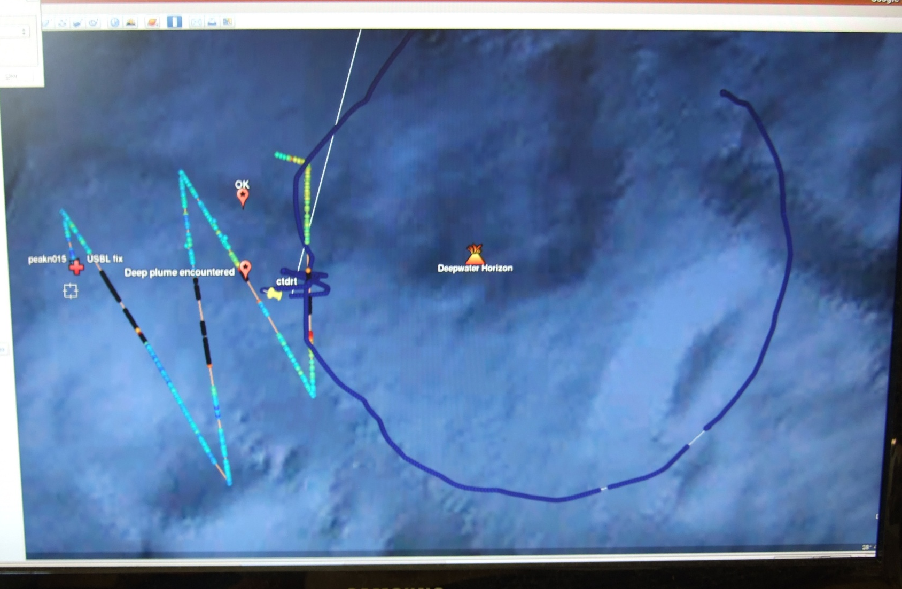
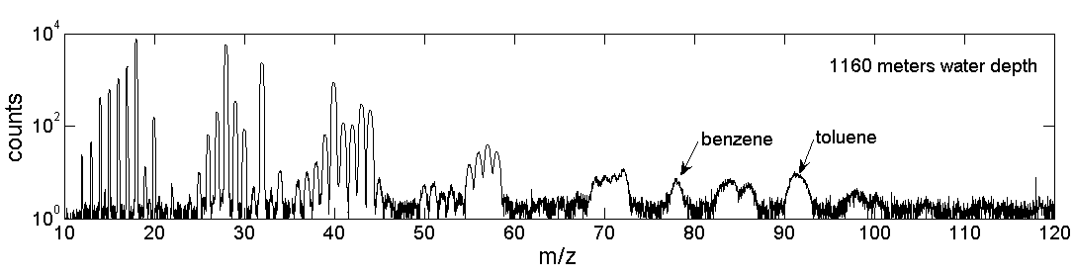

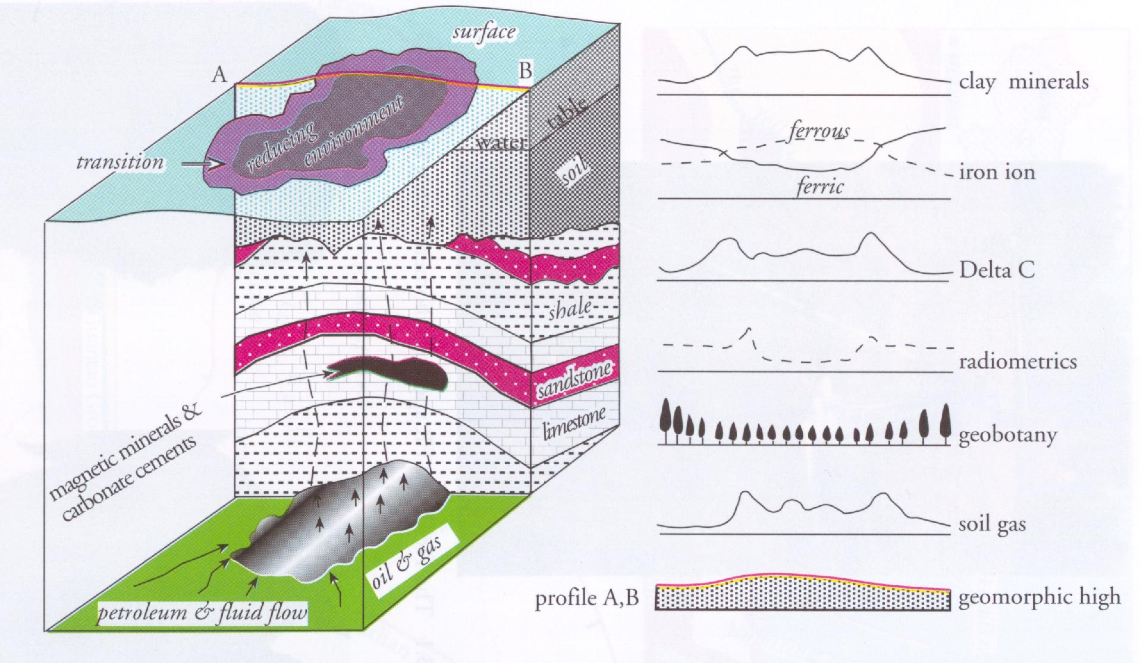
Growing our business – enabling technologies
What will make a difference ? Remote sensing…..
Cairn Lanka, 2013 UGC-PRDS Developing E&P Competency, Geo-Workshop, Negombo, Sri Lanka, January 2013
TETHYS: mass spectrometer- low molecular weight gases and volatile organics.
No moving parts
Depth to 5000 m
Mass Range 2-200 AMU
Detection Limit ~1 ppb
Sampling resolves chemical distributions to < 1 m
(Camilli 2010)‏ Wood’s Hole
(Camilli and Duryea, 2009)‏

Slide 30
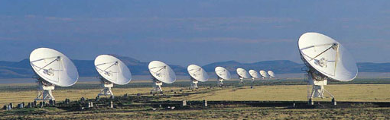
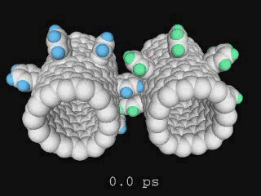
Growing our business – enabling technologies
What will make a difference ? Collaboration and team working……
Cairn Lanka, 2013 UGC-PRDS Developing E&P Competency, Geo-Workshop, Negombo, Sri Lanka, January 2013
The age of the individual is past…….team working
Accessing the right technology
Partnerships
Designer materials age . . . . .
  “If we haven’t got it, we can make it”
Molecular modelling
Integrated systems & sensors
Information Systems for data management
Computing power
Early prediction of P90 please ! Barnett Shale

Slide 31
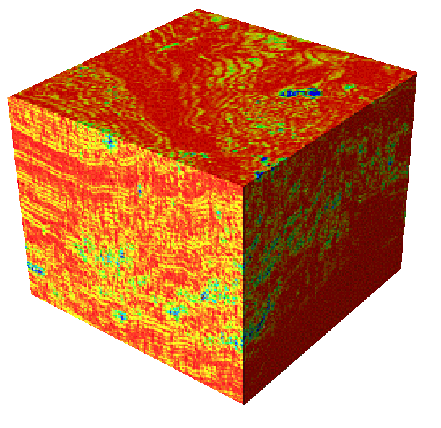
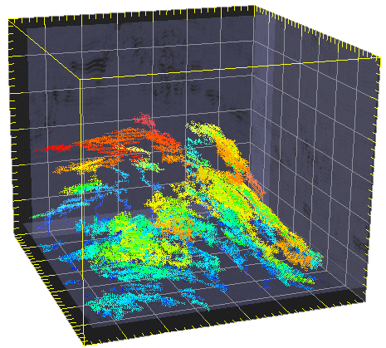
Conclusions
You can make a difference
Cairn Lanka, 2013 UGC-PRDS Developing E&P Competency, Geo-Workshop, Negombo, Sri Lanka, January 2013
Partnership and team - working, creativity and innovation
Global
The E&P business is ‘high tech’
Enormous business benefit from technology
Essential to have government commitment
But most funding will have to come from industry
Invest in best quality data collection and manage it – archive and access
Partnerships are key – JIPs especially effective
Closer collaboration is essential
Think creatively for new partnerships

Slide 32
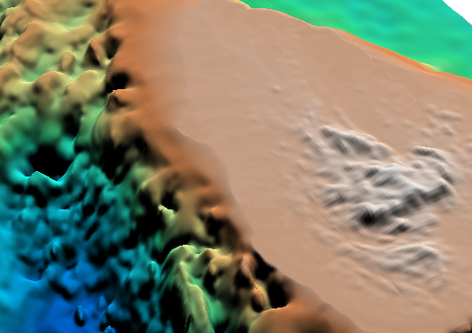
Cairn Lanka, 2013 UGC-PRDS Developing E&P Competency, Geo-Workshop, Negombo, Sri Lanka, January 2013
Thank you
Sri Lanka, depth to basement, 3D perspective view

