Slide 1
Challenges of the Sri Lanka’s Petroleum Industry by R. H. S. Samaratunga Secretary, Ministry of Petroleum Industries

Slide 2
Challenges of the Sri Lanka’s Petroleum Industry
Global Scenario in Brief
Sri Lanka’s Petroleum Industry Structure
Demand, Supply and Challenges

Slide 3
Challenges of the Sri Lanka’s Petroleum Industry
Global Scenario
Consumption
Global : 90/mb/day (2011)
OECD : 50% (appox)
North America: 24%
Production
OPEC: 37% North America: 15%
Russia: 11% Saudi Arabia: 10%

Slide 4
Challenges of the Sri Lanka’s Petroleum Industry
Petroleum product prices: increasing trend
Short term demand: price inelastic
Current scenario:- Weaker demand in EU
- Supply side uncertainties
- Additional supplies
- Downward stock adjustment

Slide 5
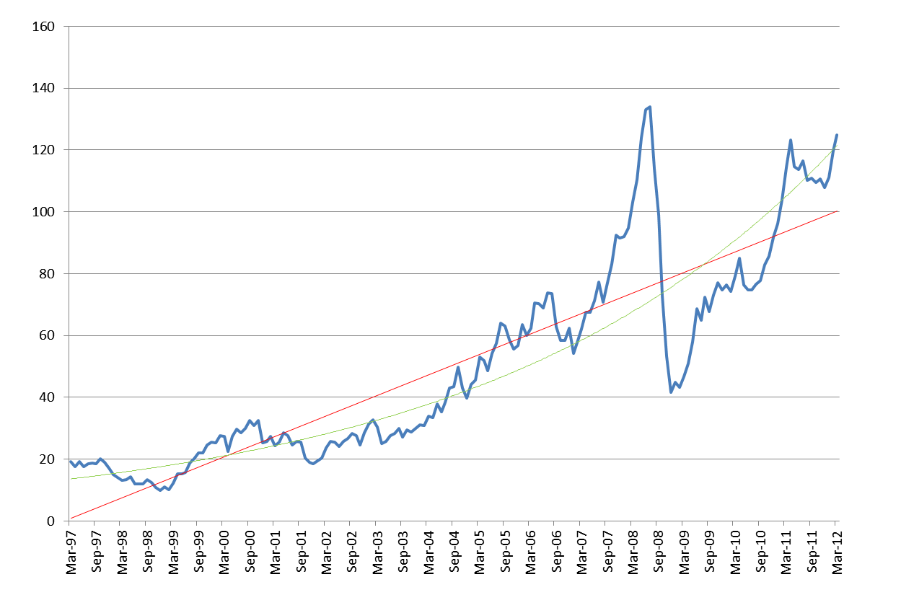
Brent Crude Oil Prices 1997 - 2012
US$/Bbl

Slide 6
Challenges of the Sri Lanka’s Petroleum Industry
Sri Lanka’s Petroleum Industry
Import dependent petroleum consumer
Prior to nationalization: oligopoly of imports/distribution
1961 - creation of state monopoly
2003 - end of state monopoly and creation of duopoly (CPC and LIOC)
Island-wide presence
Many players in several petroleum product markets: bunkering, lubricants
Case for regulating the market: products quality, services quality maintenance and enforcement
Employment 600-700 (1970s); now 6000-7000

Slide 7
Challenges of the Sri Lanka’s Petroleum Industry
Market Structure of Petroleum Product Distribution
Period | Products | Market structure | Market players
Prior to 1961 | All products | Oligopoly | Caltex, Mobil, Shell
1961-2003 | All products | Monopoly | CPC
2003 to date | Petrol, diesel, kerosene, bitumen | Duopoly | CPC, LIOC

Slide 8
Challenges of the Sri Lanka’s Petroleum Industry
PG was a private monopoly, nationalized and again privatized
Presently a duopoly market - Litro (govt.); Lauhfs
(private)
Both are import dependent to a larger extent

Slide 9
Petroleum Products Consumption by Sector

Slide 10
Challenges of the Sri Lanka’s Petroleum Industry
Demand, Supply and Challenges
Importer of refined products: beginning till late 1960s
Only refinery commissioned in 1969
Refinery met the country requirement in total for about a decade
Since then a larger part of key products/total demand for kerosene from the refinery
Currently about third of the country requirements met from the refinery

Slide 11
Challenges of the Sri Lanka’s Petroleum Industry
Rising domestic demand: petrol, diesel, fuel oil
Fuel oil demand: depends on the rain- inverse relationship
Declining demand: kerosene

Slide 12
Growth Rates of Refined Petroleum Products
Year | Growth Rate (%)
 | Petrol | Diesel | Kerosene | Fuel Oil
1990 | - | - | - | -
1995 | -8.34 | 57.81 | 12.41 | 8.65
2000 | 32.49 | 79.46 | 5.03 | 26.04
2001 | 7.07 | 2.64 | -3.67 | -0.68
2002 | 21.13 | 0.73 | 11.05 | 9.91
2003 | 10.85 | -6.46 | -27.52 | -14.76
2004 | 12.52 | 21.43 | 28.38 | -0.71
2005 | 27.54 | 19.39 | -6.71 | 68.68
2006 | -5.78 | 4.19 | -3.23 | -13.81
2007 | 16.29 | 4.05 | -34.91 | -10.11
2008 | 4.75 | -9.59 | -5.93 | 0.68
2009 | 0.05 | -1.65 | 9.2 | 16.33
2010 | 18.21 | 4.21 | -23.56 | -6.84
2011 | 15.47 | 15.99 | 0.13 | 9.14

Slide 13
Furnace Oil Annual Sales Volume (MT)
Furnace Oil Annual Sales Value (Rs/Mn)

Slide 14
Challenges of the Sri Lanka’s Petroleum Industry
Rapidly rising overall demand
Petroleum accounts for 24% of import bill and 45% of exports (2011)
Demand doubled during last three years (in value terms)
More on refined products
More resources required for imports in absolute and relative terms in the future

Slide 15
Year

Slide 16
Year

Slide 17
Challenges of the Sri Lanka’s Petroleum Industry
Sri Lanka: price taker, import quantity being very small
Periodic price revisions from 2005: upward/downward
- international price trends
- subsidy levels for each product
- CPC’s financial status etc.

Slide 19
International Market Prices and Government Subsidy

Slide 20
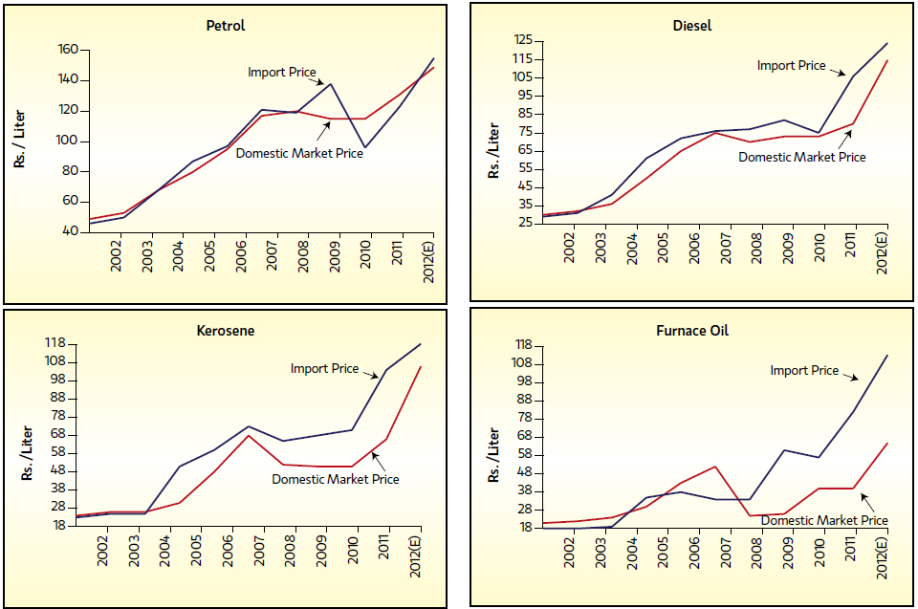
Import Prices Vs. Domestic Market Prices

Slide 21
Challenges of the Sri Lanka’s Petroleum Industry
State control in pricing during the monopoly era
Price revision by LIOC on its own or LIOC can follow the government program of revision
As the largest share of market is with CPC, major price changes by the competitor becomes ineffective
2011 Petrol 80%
Diesel 95%
Kerosene 100%

Slide 22
Challenges of the Sri Lanka’s Petroleum Industry
Increased power supplies to be met from oil based electricity
generation : 2010 - Gwh 10714 of which thermal: 46.7%
2011 - Gwh 11528 of which thermal: 49.9%
Fuel oil is also subsidized, affecting CPC financial status
Electricity consumption is subsidized and also regulated
(average unit cost: Rs 15.59 against selling price of Rs. 13.22)
Stable electricity supply

Slide 23
Electricity Generation / Gwh
Year | Thermal | Other
2006 | 4751 | 4638
2007 | 5865 | 3950
2008 | 5763 | 4138
2009 | 5975 | 3908
2010 | 4994 | 5720
2011 | 5748 | 5781

Slide 24
Challenges of the Sri Lanka’s Petroleum Industry
Refinery provided: entire requirement in 1970s
1990s: about one half met from refinery
2010: about 35 met from the refinery
Increasing demand met from imported refined products
(on expenditure basis)
Change due to: fixed processing capacity and increased
demand

Slide 25
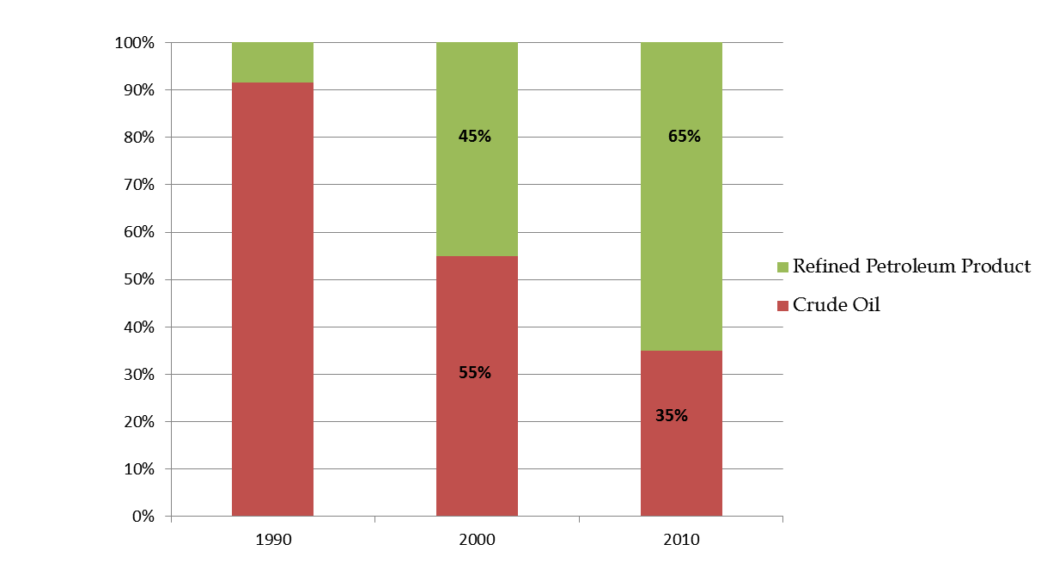
Crude Oil & Refined Petroleum Product Import Ratio
Product | 1990 | 2000 | 2010
Refinery Output | 91.5 | 55 | 35
Imported Refined Petroleum Products | 8.5 | 45 | 65
Percentage (%)
8.5%
91.5%
Year

Slide 26
Challenges of the Sri Lanka’s Petroleum Industry
Refinery’s technological limitations:
- built in 1960s
- can accommodate limited crude types
- low yield and value addition

Slide 27
Challenges of the Sri Lanka’s Petroleum Industry
Current tension in the Middle East/supply uncertainties
gulf region: 20% of global petroleum exports
30% LNG exports
Diversification of sources of supply
- crude oil (technological issues)

Slide 28
Thank You

