Slide 1
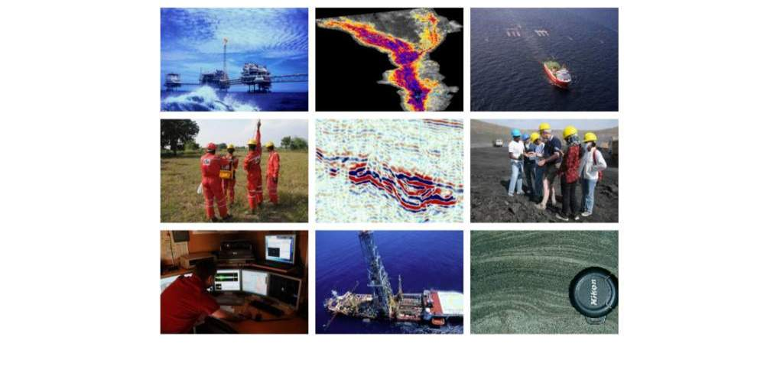
Oil & Gas Competency Building Workshop
Introduction to the Exploration & Production Industry
The E&P Business Lifecycle – Timescales and Drivers
Stuart Burley
Head of Geosciences, Cairn India

Slide 2
Contents
The E&P Business Lifecycle – Timescales and Drivers
An introduction to the concepts, techniques and tools that are used in the exploration for and production of oil and gas
The E&P business model
Some important concepts
Exploring for hydrocarbons
Drilling a well
Field appraisal and development – how much oil or gas have we got ?
Production operations and E&P facilities
Abandonment of wells
Conclusions

Slide 3
The E&P business model
Upstream Funnel Stages
Field
Abandonment
Exploration
Appraisal &
Development
Production
Operations
Exploration
  Acquire seismic and other geophysical data to image the subsurface
  Develop an understand the subsurface geology
  Using this understanding, be able to predict where oil and gas might be trapped
  Identify targets for exploration, and then drill wells to search for hydrocarbons
          Appraisal & Development
            Once a discovery is made, define field size (how much ?)
            Characterise the reservoir to optimise development
            Define how to best get oil and gas out of the reservoir
            Make a field development plan for government approval
              Production Operations
              - Physically recover the oil and gas
              - Optimise for maximum production
              - Enhanced recovery

Slide 4
The E&P business lifecycle – time to investment return
Exploration
5 – 8 yrs
Development
3 – 5 yrs
Production
10 – 30 yrs
Abandonment
3 – 5 yrs
Large amounts of up-front investment (CAPEX), enormous operating costs (OPEX), risk and uncertainty, and long project lifecyles
Time to investment return is typically 10-15 years – best case 4-5 years

Slide 5
Content
The E&P Business Lifecycle – Timescales and Drivers
An introduction to the concepts, techniques and tools that are used in the exploration for and production of oil and gas
The E&P business model
Some important concepts
Exploring for hydrocarbons
Drilling a well
Field appraisal and development – how much oil or gas have we got ?
Production operations and E&P facilities
Abandonment of wells
Conclusions

Slide 6
E&P requires integrated, highly skilled, multi-disciplinary teams
Geophysics
Projects
Engineering
Geology
Reservoir
Engineering
Facilities
Engineering
Geochemistry
Completions
Engineering
Petrophysics
Support Services
Production
Optimisation
Drilling
HSE
Commecial analysis
Integrated multi-disciplinary teams composed of skilled professionals working together, including both operator staff, national bodies and regulators, along with contractors and academic research groups, lead to improved performance (safety, financial, knowledge) at all stages of the E & P cycle

Slide 7
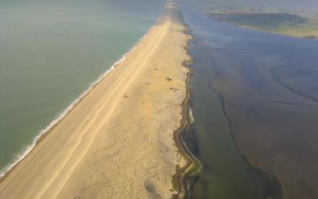
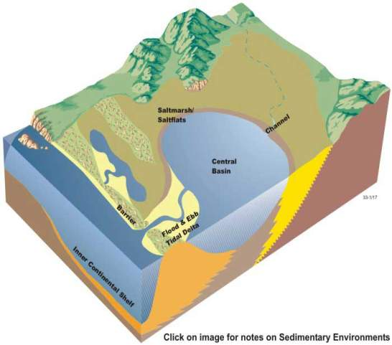
Scale, data and uncertainty
Sedimentary basins accumulate sediments through geological time
Deposition of sediment follows distinct patterns
Depositional systems
Present is key to the past
Conceptual model of a sedimentary basin
Petroleum Geologists have to understand the distribution of reservoirs

Slide 8
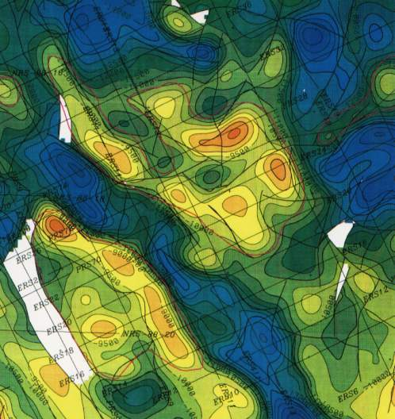
Subsurface exploration techniques and risking
The image is a map of a subsurface layer
To drill a well here might cost the Company anything between US$10million and US$100million
Which structure contains hydrocarbon resources ?
  how much ?
  oil or gas ?
The basin high is called a ‘prospect’
The exploration process is to increase the chance of finding hydrocarbons through a better understanding of the subsurface and petroleum systems
Minimize lost money, add resources
Basin lows – oil/gas sources
Basin highs – traps

Slide 9
An introduction to the oil and gas industry
Business decisions are based on these estimates
Risking is the way in which we manage uncertainty
EMV (expected monetary value) = CoS x NPV
  CoS = Chance of Success (0 - 100%)
  = Chance of Reservoir x Chance of Source x Chance of Trap x Migration efficiency
  Derived from calculations and basin models built by geoscientists
  NPV = Net Present Value
  NPV = Revenues – Costs
  Revenues = Production Profile x price
  Costs = Capex + Opex + Taxes
  ROR = Rate of Return
  PBIT = Profit before Income Tax
Production Profiles and reserves are derived from reservoir models which are built by subsurface staff
Costs are derived by upstream engineers based on the development plan

Slide 10
Estimating how much oil and gas a prospect contains
Because we can never sample the whole reservoir, we never know exactly how much oil or gas is present – we make estimates
16
P50
14
12
P90
10
P10
08
Probability %
06
04
02
00
0
Resources – oil or gas in place
A lot
It’s a very uncertain business………………………...
But we plan for and manage uncertainty

Slide 11
Exploration is a risky, uncertain, data-poor business
We never have enough data
Always uncertainty
‘What if ?’ questions
As explorationists we investigate the sensitivity of petroleum systems to critical elements of the geology to the presence of oil and gas
Seismic provides spatial framework and rock property data for 3D models
No unique modelled solution until well is drilled
Even then not all the geological system will be known
Continuously collect more data
The very best data quality is essential to reduce risk and costs

Slide 12
Content
The E&P Business Lifecycle – Timescales and Drivers
An introduction to the concepts, techniques and tools that are used in the exploration for and production of oil and gas
The E&P business model
Some important concepts
Exploring for hydrocarbons
Drilling a well
Field appraisal and development – how much oil or gas have we got ?
Production operations and E&P facilities
Abandonment of wells
Conclusions

Slide 13
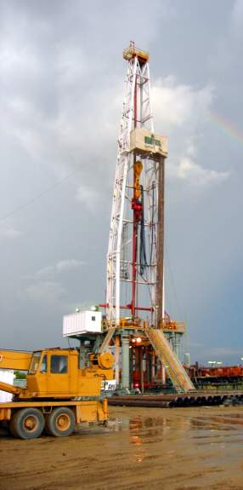
Exploration – finding some oil and gas
Aims of Exploration
  Find commercial hydrocarbons by drilling wells on prospective structures
Tools
  Seismic data – acquisition, processing and interpretation
  Geological evaluation and modelling
  Well data evaluation, including petrophysics and core studies
  Expert knowledge and integration
Metrics
  Safety
  Chance of Success of having a commercial field (CoS)
  Prospective Hydrocarbon Resources
Ultimate goal – Field discovery

Slide 14
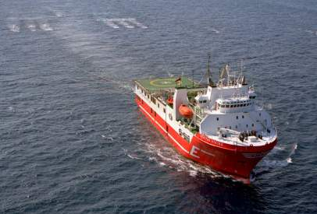
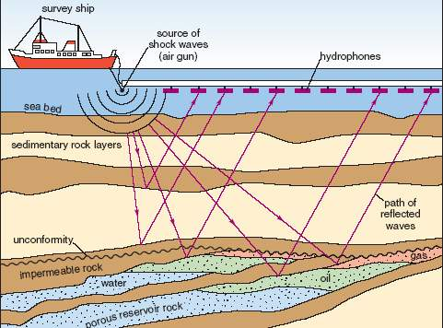
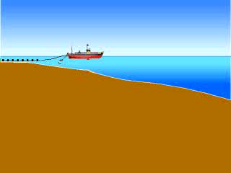
Seismic surveys – the key tool in exploration
Seismic data is the main tool used to select locations for wells and determine the size of the accumulation
Seismic data also gives information regarding reservoir properties and fluid content
Seismic data is acquired by sending an energy pulse into the earth and interpreting the reflected waves after complex mathematical processing (rather like sonar)
Seismic data can be processed as vertical slices (2D) or a 3D cube (3D)

Slide 15
Content
The E&P Business Lifecycle – Timescales and Drivers
An introduction to the concepts, techniques and tools that are used in the exploration for and production of oil and gas
The E&P business model
Some important concepts
Exploring for hydrocarbons
Drilling a well
Field appraisal and development – how much oil or gas have we got ?
Production operations and E&P facilities
Abandonment of wells and suspension
Conclusions

Slide 16
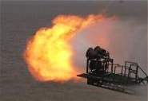
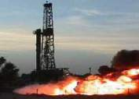
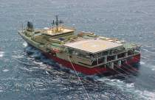
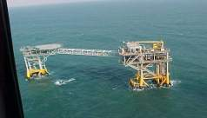
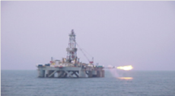
Drilling the well and data from wells
Drilling a well into a reservoir is the only way to prove the presence of oil & gas
A well is created by drilling a hole in the Earth with an oil rig or drill ship which rotates a drill string and drill bit
After the hole is drilled, a steel pipe – the casing - slightly smaller than the bit size, is lowered into the hole, and secured with cement
Perforation with explosives through the casing of the well is done to make flow channels to the reservoir
After perforation, the well is ready to flow oil and gas, if the reservoir has sufficient permeability and pressure, to test the flow rates
Electronic tools are run in the hole to measure the properties of the rocks
Samples can be taken by coring

Slide 17
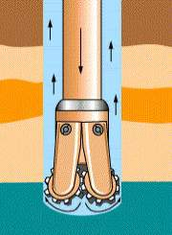
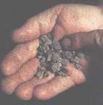
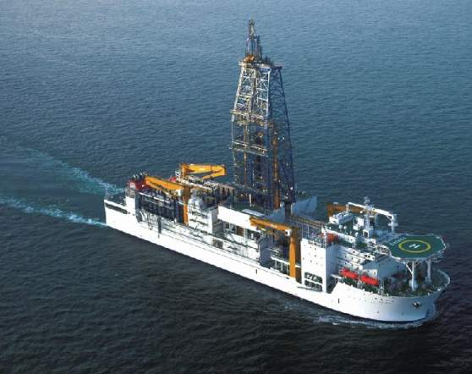
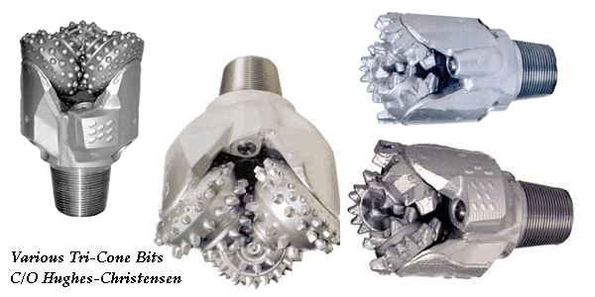
Drilling and drilling techniques
Typical daily cost for a
drill ship
2000 $100,000
2007 $200,000
2012 $500,000
An offshore drilling ship

Slide 18

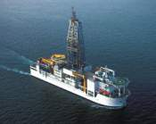
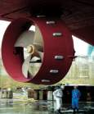
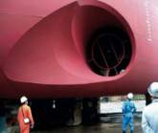
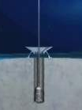
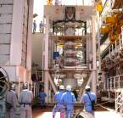
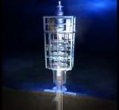
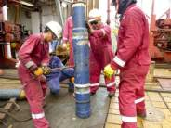
How we drill wells in deep water

Slide 19
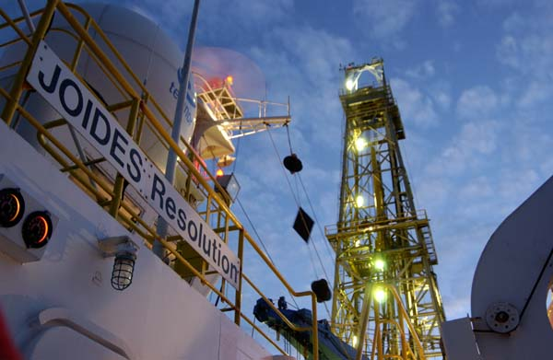
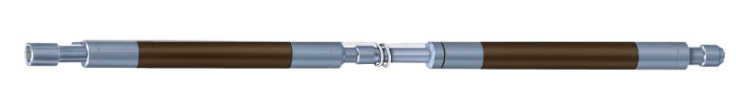
What happens when we reach the target depth ?
Once the well has reached its target depth, measurements of rock and fluid properties are made
  Some measurements are made ‘real time’
  Most are done later, either before or after casing is set
These are done with tools that are run in the hole on a wire – hence the term ‘wireline’
  Determine the type and age of the rock
  Sometimes take samples of rock and fluid
Tools have to be run in the hole and then pulled out
  These ‘trips’ take several hours depending on hole depth
  The digital information then has to be downloaded for interpretation

Slide 20
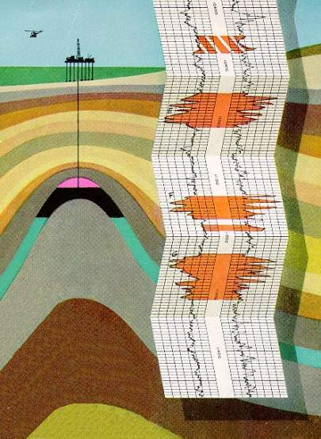
Well logging - petrophysics
The well logging procedure consists of lowering a 'logging tool' on the end of a steel wire into the well to measure the rock and fluid properties of the formation.
These logging tools are highly sophisticated and designed for the industry
An interpretation of these measurements is then made to locate and quantify potential depth zones containing oil and gas.
This data is recorded to a printed record called a 'Well Log'.
The well logging tools help geologists understand the rock properties:
    Presence of reservoir
    Presence of hydrocarbons
    Reservoir properties

Slide 21
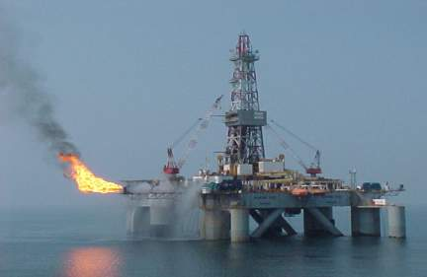
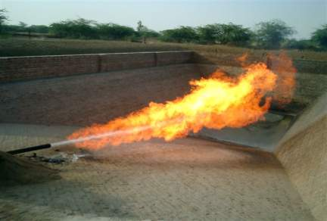
Well testing – making hydrocarbons flow to surface
  Productivity well tests are conducted to
    Identify produced fluids
    Measure reservoir pressure and temperature
    Obtain samples suitable for PVT analysis
    Determine well deliverability
  Reservoir tests are conducted to
    Evaluate reservoir parameters
    Characterize reservoir heterogeneities
    Assess reservoir extent and geometry
    Determine communication between wells

Slide 22
Content
The E&P Business Lifecycle – Timescales and Drivers
An introduction to the concepts, techniques and tools that are used in the exploration for and production of oil and gas
The E&P business model
Some important concepts
Exploring for hydrocarbons
Drilling a well
Field appraisal and development – how much oil or gas have we got ?
Production operations and E&P facilities
Abandonment of wells
Conclusions

Slide 23
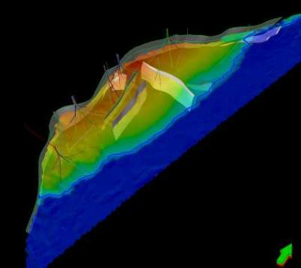
Appraisal – how much oil and gas have we got ?
Aims of Appraisal
To provide an accurate estimate of hydrocarbon reserves in order to make the right decision about whether and how to develop the hydrocarbon discovery
Key tools
  Geological and geophysical interpretation
  Well test data evaluation
  Reservoir modelling
Key Metrics
  Safety
  Reserves
  Development plan, meeting economic targets
Ultimate goal
  Project sanction – approval to develop the field

Slide 24
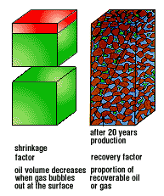
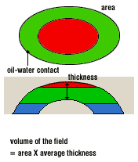
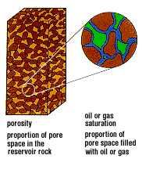
How much oil and gas have we got ?
GROSS ROCK VOLUME
POROSITY AND SATURATION
RECOVERY
Resources and Reserves
Hydrocarbons in Place = GRV x N/G x Porosity x Saturation x Formation Volume Factor
Reserves = Hydrocarbon in Place x Recovery Factor

Slide 25
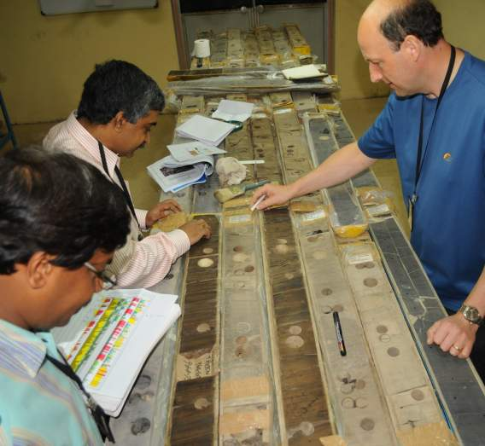
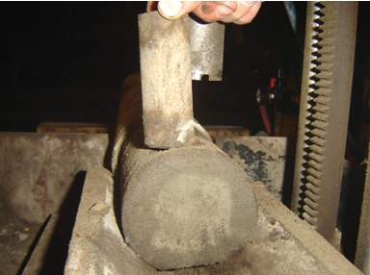
Petrophysics – rock properties to calculate volumes
Data from core
Core provides the only ‘real’ information from the subsurface
Analyses are undertaken on the core to understand the rock properties
Horizontal
Plug
Uninvaded core centre

Slide 26
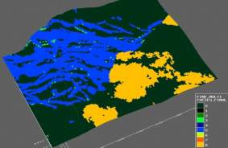
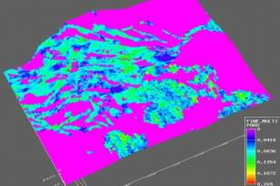
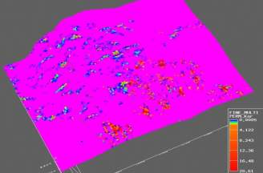
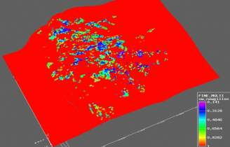
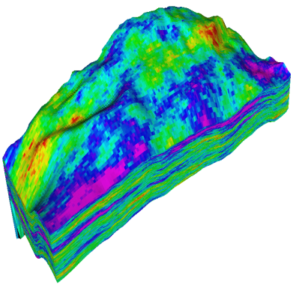
Appraisal – reservoir models to calculate volumes
Facies conditioned to wells,
seismic and facies rules
Channels
& splays
Mouthbars
Variogram co-simulation of Phi and K
conditioned to wells and seismic
Coarse scale dynamic grid
Over-
bank shale
Sw / Ht function
Facies
Porosity
Permeability
Sw
  3D porosity model
Geophysical, geological and engineering data collected on the field are used as input to a computer model that simulates the reservoir and its behaviour

Slide 27
Content
The E&P Business Lifecycle – Timescales and Drivers
An introduction to the concepts, techniques and tools that are used in the exploration for and production of oil and gas
The E&P business model
Some important concepts
Exploring for hydrocarbons
Drilling a well
Field appraisal and development – how much oil or gas have we got ?
Production operations and E&P facilities
Abandonment of wells and suspension
Conclusions

Slide 28
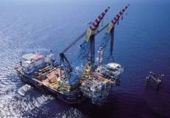
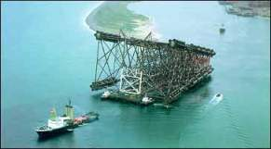
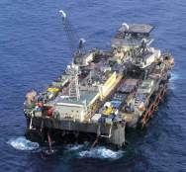
Development and Production Operations
Aims of Production Operations
  Safely and economically install, the appropriate facilities in order to optimally produce the hydrocarbon reserves in the field
Key Stages – Drilling development wells and safely producing hydrocarbons
  Installing well production equipment (completions)
  Installing the surface facilities (platforms, pipelines)
  Testing and commissioning the facilities
  Producing hydrocarbons and delivery to pipelines or vessels
Key Metrics – Safety, Costs, Reserves, schedule
Ultimate Goal – Safe Production

Slide 29
Production methods
Primary Depletion
  Reservoir at high pressure, joined to low pressure at surface by the well. Pressure declines as fluids are produced. Used mainly for gas fields.
Pumping and Compression
  Eventually field pressure is no longer sufficient to lift the fluid – assistance is provided by pumping (for oil fields) or compression (for gas fields)
Secondary pressure maintenance
  production maintained if pressure is kept high by injecting water or gas into the reservoir, through dedicated wells. Used in most oil fields today.
Tertiary production and special methods
  include steam or detergent floods – used for heavy or waxy oils only –tend to be expensive and require much supporting technology
  Production strategy is decided during the development plan and is based on maximum economic returns

Slide 30
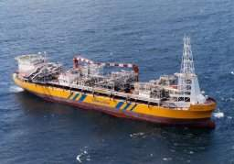
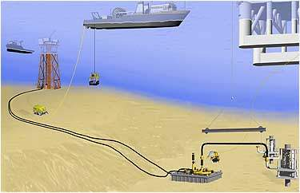
Field Development Projects – facilities
Offshore Projects
Often use deviated wells
  Drilling radius defines number of drill centres or hubs
Water depth has a large influence on development concept & costs
  Wellhead jackets in shallow water – unmanned
  Fixed platforms up to 500m water depth
  Floating platforms
  Production vessels
  Subsea developments

Slide 31
Content
The E&P Business Lifecycle – Timescales and Drivers
An introduction to the concepts, techniques and tools that are used in the exploration for and production of oil and gas
The E&P business model
Some important concepts
Exploring for hydrocarbons
Drilling a well
Field appraisal and development – how much oil or gas have we got ?
Production operations and E&P facilities
Abandonment of wells and suspension
Conclusions

Slide 32
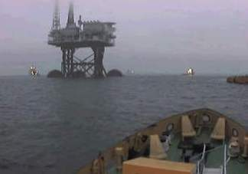
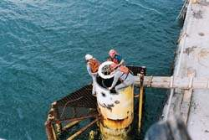
Abandonment – safe and economic removal of facilities
Aims of abandonment – to safely and economically remove wells and installed facilities in order to comply with local laws, international conventions and company policy.
Key Stages – deciding when to cease production – decision made on economic limits with the help of the reservoir model
Key Metrics – Safety, Costs, schedule, environmental factors
Ultimate Goal – Safe facilities removal
Decommissioning a spar
North Sea platform re-float for decommissioning

Slide 33
Content
The E&P Business Lifecycle – Timescales and Drivers
An introduction to the concepts, techniques and tools that are used in the exploration for and production of oil and gas
The E&P business model
Some important concepts
Exploring for hydrocarbons
Drilling a well
Field appraisal and development – how much oil or gas have we got ?
Production operations and E&P facilities
Abandonment of wells and suspension
Conclusions

Slide 34
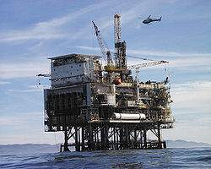
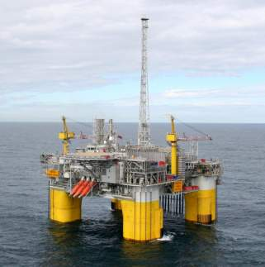
The E & P business - Conclusions and Summary
Prospecting for and producing oil & gas is a highly technical but regulated activity
The E & P industry employs experienced & highly trained professionals to ensure a high standard of HSE and maximise success rate and recovery
Drilling & testing is the only sure way of confirming the presence of hydrocarbon and conduct assessment of the reservoir
Hydrocarbon exploration is expensive and the success rate is low – making it a high investment risk but high potential gain industry
Planning and management are needed to ensure good investment decisions are made and facilities are optimised
New players in the business have good prospects for partnering in niche roles – understand your existing skill sets and build upon them

