Slide 1
Best teaching practices in Geosciences and Industry-Academic Cooperation
Jonathan Redfern
&
Nigel Banks

Slide 2
The Petroleum Industry
Upstream
- Exploration and production of oil and gas
Midstream
- Transport (pipelines, tankers, etc)
Downstream
- Refining, petrochemicals and marketing

Slide 3
E&P requires integrated, highly skilled, multi-disciplinary teams
Geophysics
Projects
Engineering
Geology
Reservoir
Engineering
  Facilities
  Engineering
Geochemistry
Completions
Engineering
Petrophysics
Support Services
Production
Optimisation
Drilling
HSE
Commercial analysis
Integrated multi-disciplinary teams composed of skilled professionals working together, including both operator staff, national bodies and regulators, along with contractors and academic research groups, lead to improved performance (safety, financial, knowledge) at all stages of the E & P cycle

Slide 4
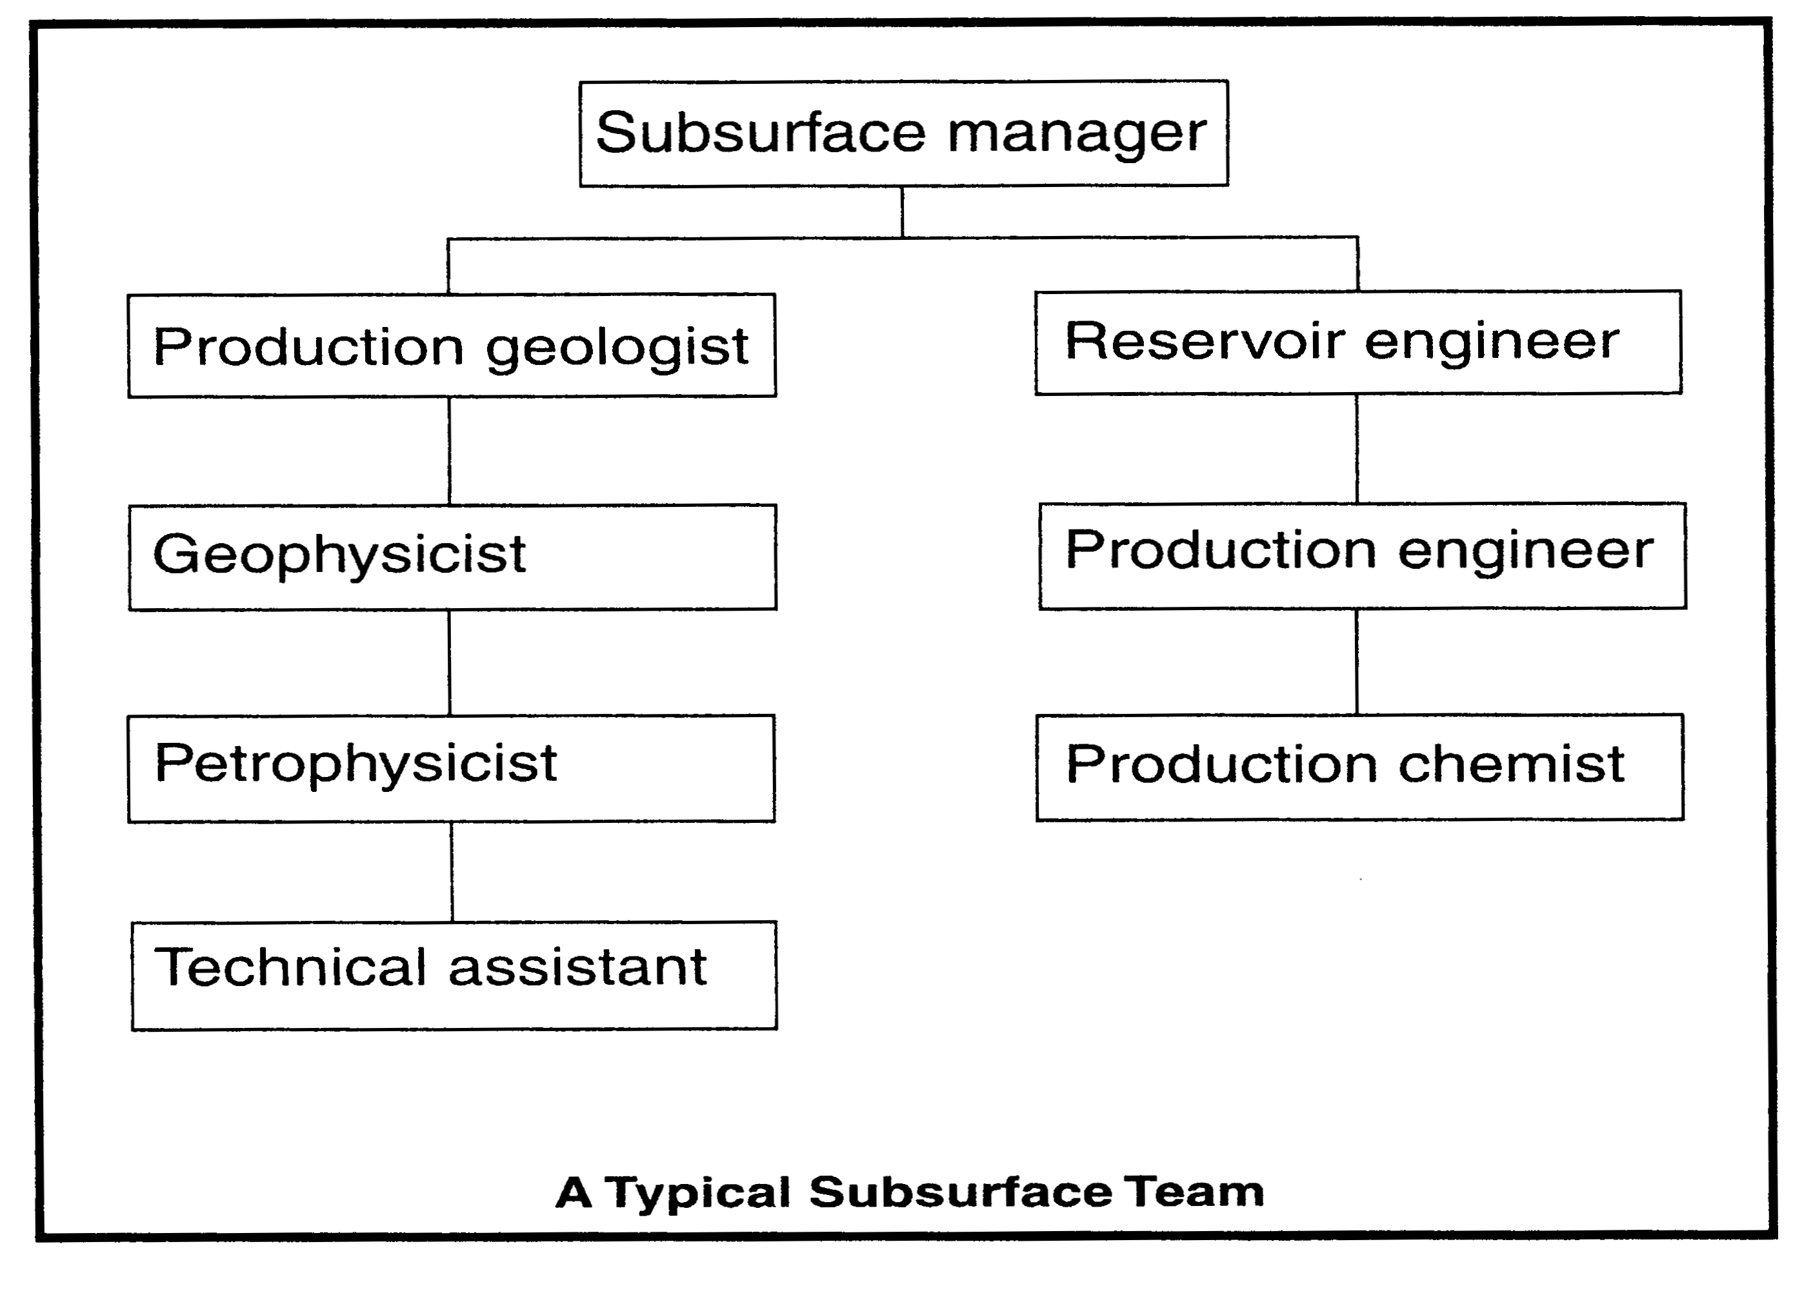
A development subsurface team
Shepherd (2009)

Slide 5
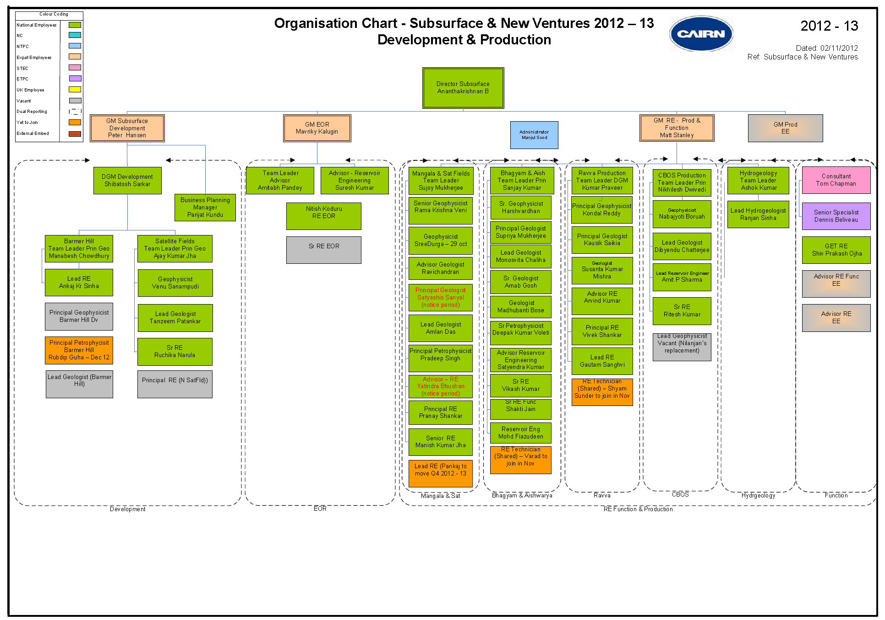

Slide 6
The range of skills required
Exploration & Production
  Geologist, geophysicists, drilling engineers, petrophysicists, reservoir engineers, EHS specialists, economists, lawyers.
Production
  Geologist, geophysicists, drilling engineers, petrophysicists, reservoir engineers, production engineers, production technologists, facilities engineers, EHS specialists, economists, lawyers

Slide 7
Geological and Geophysical specialisations
Geophysicists
Geologists
Seismic Acquisition
Seismic Processing
Seismic Interpretation
Rock physics specialists
Gravity and magnetics
New ventures geologists
Exploration geologists
Production geologists
Geochemists
Sedimentologists
Structural geologists
Well site & Operations geologists

Slide 8
Building Capacity in Tertiary Education
Petroleum Geoscience, Engineering and related fields

Slide 9
How might UK universities help?
Petroleum-related M.Sc courses provide a very efficient one year introduction to many upstream skills
  Funding from oil companies or British Council
University to University Collaboration
  Joint research projects with PhD students
  Assistance with setting up in Sri Lanka:
    Undergraduate modules in petroleum-related skills
    Post-graduate petroleum-related courses feeding into international M.Sc or oil company secondment

Slide 10
Capacity Building
Developing achievable goals
  1 year / 5 year / 10 year plan
Accessing Funding Source
Establish University collaborations (MOU)
  Research
  Teaching
Training the Trainers
Curriculum and Courses
  Developing undergraduate programmes
  Developing master programmes?
  CPD Training for employees
Research Collaboration
  Joint PhDs
  Academic collaboration

Slide 11
UK Taught Programmes
Undergraduate (3-4 years)
  Geology and Geophysics
    Petroleum Geoscience
  Engineering
    Petroleum Engineering
  Environmental Science
  Business Studies / Economics
Postgraduate (MSc) (1 year)
  Petroleum Geoscience / Geophysics
  Petroleum Engineering
  Environmental Science and Pollution Control
  Business Studies

Slide 12
UK Research Programmes
Jointly supervised research projects / sponsored students
  Accessing experience, expertise and facilities
  Access training / experience for students and staff
Pilot studies / Joint Projects
PhDs jointly supervised
Key Criteria
  Quality students / staff
  Fully funded projects
    MSc 1 year £35,000
    PhD 3-4 years, typically £100,000
  Access to data

Slide 13
Main Petroleum Research/Teaching Universities in UK
University of Manchester
  Undergraduate
    Geology, Environmental Science, Petroleum Engineering (BEng/MEng)
  Masters
    Petroleum Geoscience for Exploration
    Petroleum Geoscience for Reservoir Development and Production
    Masters by Research
  Postgraduate
    PhDs (Typically 30+ sponsored mainly by oil industry

Slide 14
Main Petroleum Research/Teaching Universities in UK
Imperial College
  Undergraduate
    Geology, Environmental Science, Petroleum Engineering(BEng/MEng)
  Masters
    Petroleum Engineering
    Petroleum Geophysics
    Petroleum Geology
  Postgraduate
    PhDs (Typically 30+ sponsored mainly by oil industry)

Slide 15
Main Petroleum Research/Teaching Universities in UK
Aberdeen University
  Undergraduate
    Geology , Petroleum Engineering
  Masters
    Petroleum Geoscience
Royal Holloway University
  Petroleum Geoscience
Leeds University
  Undergraduate
  Petroleum Engineering
  Masters
    Geophysics
    Structural Geology
Heriot Watt University
  No undergraduates in geology or petroleum engineering
  MScs
    Petroleum Engineering Meng
    Petroleum Geoscience MSc

Slide 16


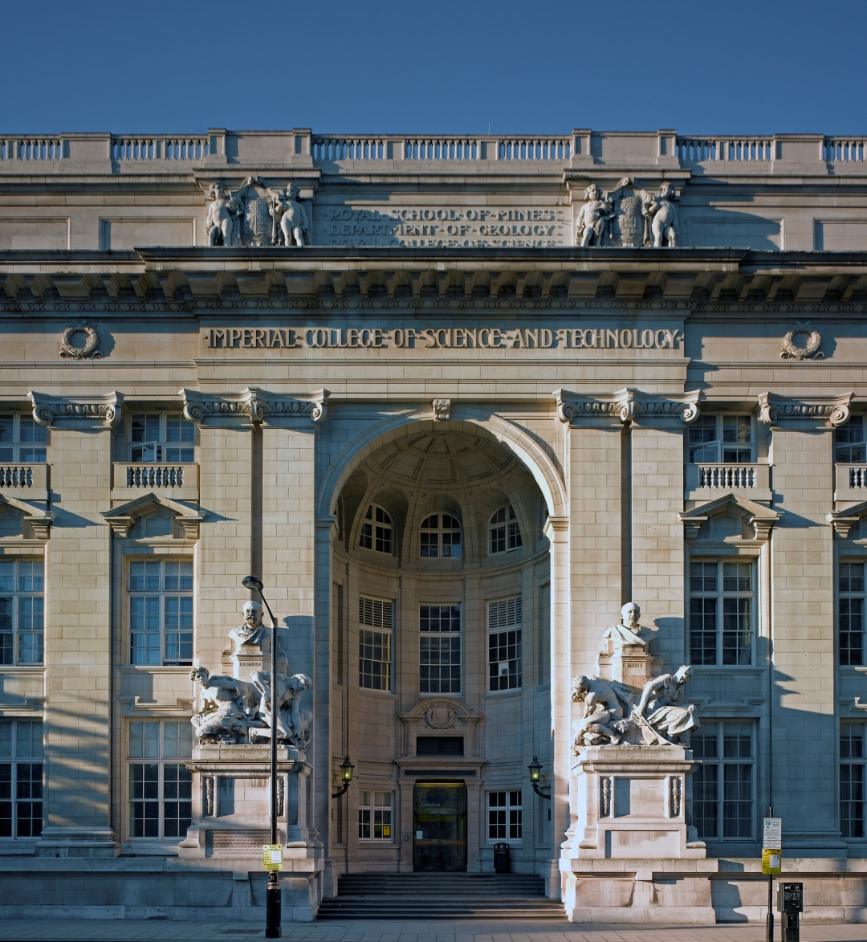
Integrated MSc Petroleum Courses at Imperial College

Slide 17

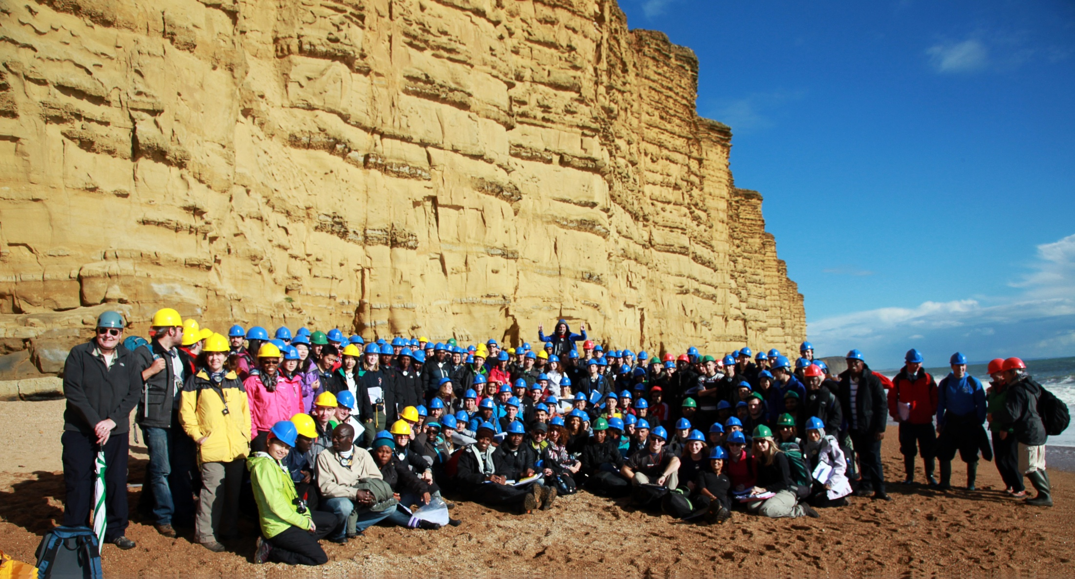
A global catchment
MSc Petroleum Geoscience: 50
MSc Petroleum Geophysics: 37
MSc Petroleum Engineering: 66 Total = 153
Bridport Sands at West Bay,
Wessex Basin (October 2012)

Slide 18

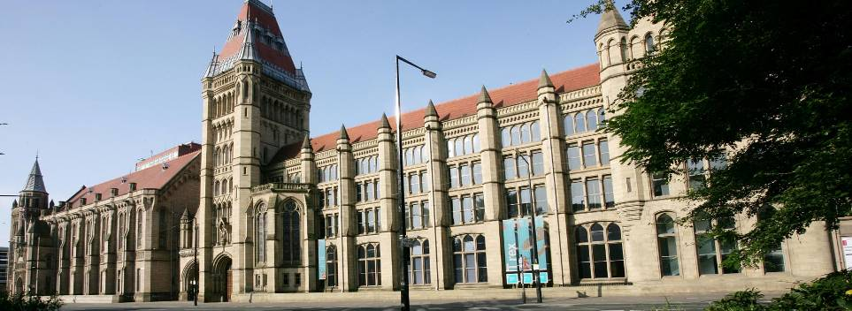
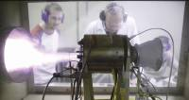
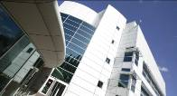


University of Manchester
School of Earth, Atmospheric and Environmental Sciences
Basin Studies and Petroleum Geoscience and Engineering

Slide 19
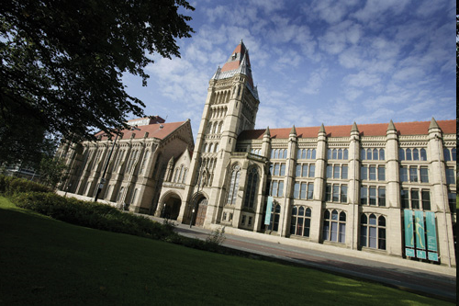
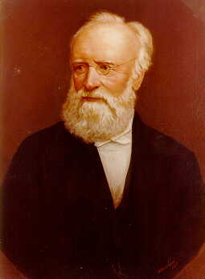
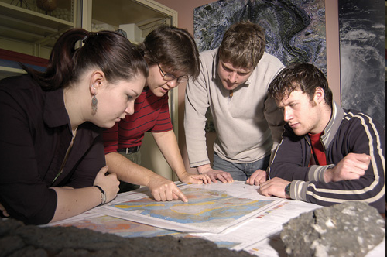
Geology and related Earth Sciences studied at Manchester since 1851, founded by W.C. Williamson, one of the great Victorian scientists, a friend of Darwin, Huxley, Lyell
Largest University in UK (40,000 students)
In top 5 Universites in UK
In world Top 50 Universities
Schlumberger centre of excellence
BP core university

Slide 20
Faculty of Science and Engineering
Schools
School of Earth, Atmospheric
and Environmental Sciences
Chemical Engineering and Analytical Science
Chemistry
Computer Science
Earth, Atmospheric and Environmental Sciences
Electrical and Electronic Engineering
Materials
Mathematics
Mechanical, Aerospace and Civil Engineering
Physics and Astronomy
Manchester Computing
Atmospheric Sciences
Basin Studies and Petroleum Geoscience
Environmental Geochemistry and Geomicrobiology
Isotope Geochemistry and Cosmochemistry
Physics and Chemistry of Minerals and Fluids
Structural and Petrological Geoscience
Palaeontology and Palaeobotany

Slide 21
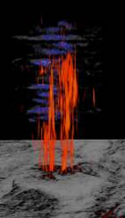

Basin Studies and Petroleum Geoscience
Petroleum MSc started in 2003
Now one of the largest Petroleum Geoscience and Engineering groups in the UK, with extensive collaborative links with world leading facilities
15+ academic staff supervising 30 PhDs and 8 Post Doctoral Researchers
£2.5million +annual research funded by international oil companies and UK Research Councils

Slide 22
Who's who in Petroleum Geoscience and Engineering
Chair of Petroleum Geoscience Prof. Jonathan Redfern
Chair of Sedimentology Prof Kevin Taylor
Chair of Development Geoscience Prof Mike Bowman
Chair of Stratigraphy Prof Steve Flint
Chair of Structural Geology Prof Ernie Rutter
Petroleum Geoscience MSc Course Director Dr Berit Legler (Sedimentology)
Petroleum Engineering BEng Course Director Dr Cathy Hollis (Petrophysics / Carbonate)
Dr David Hodgetts (Reader) Reservoir geology & modelling
Dr Mads Huuse (Reader) Seismic and Fluid Flow
Dr Stefan Schroeder Carbonate geology
Dr Neil Mitchell (Reader) Geophysics, Earth surface processes
Dr Simon Brocklehurst Earth surface process and glaciology
Dr Merren Jones Sedimentology and tectonics
Dr Steve Crovey-Crump Structural geology
Dr Julian Mecklenberg Structural geology
Dr Emma Finch Nummerical Modelling

Slide 23
Petroleum Geoscience MSc
Dedicated External Expert Teaching Team
The team also comprises a strong group of oil company specialists and consultants, including:
Prof Richard Dixon– (exploration geology & risk analysis, BP)
Prof Brian Williams : clastic reservoir sedimentology
Malcolm Mitchell – (petroleum economist 20 years with Shell)
Andrew Stocks – (petrophysics - 28 years experience),
Ted Cox – (seismic - consultant, previously with Robertson Research)
Tim Herrett – (wellsite / operations geology - 20 year experience and consultant with Cambrian Consultants and Exxon),
Alun Griffiths – (applied reservoir geology – consultant)

Slide 24
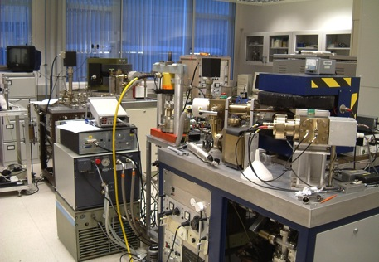
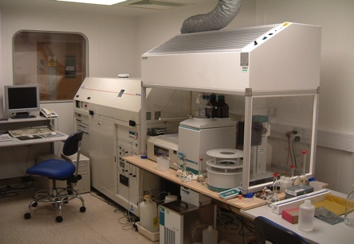
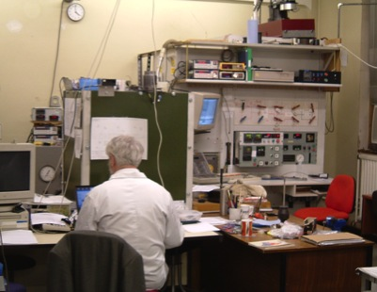
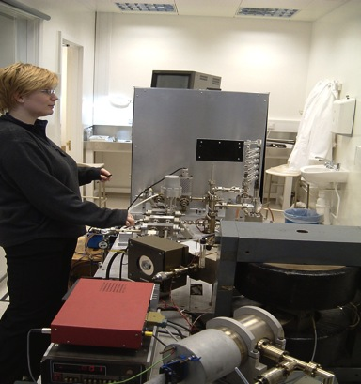
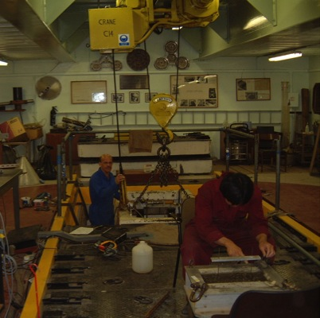
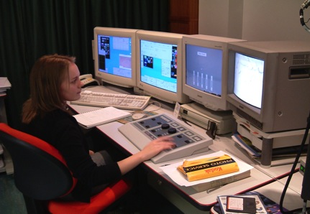
World-class research and teaching facilities across full spectrum of Earth Sciences and at all scales
Noble gas
ICP-MS
Deformation
and acoustic rigs
Ar-Ar dating
500 g/T Centrifuge
Electron microprobe/
SEM

Slide 25
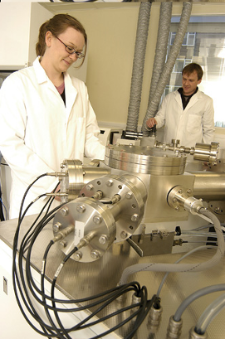
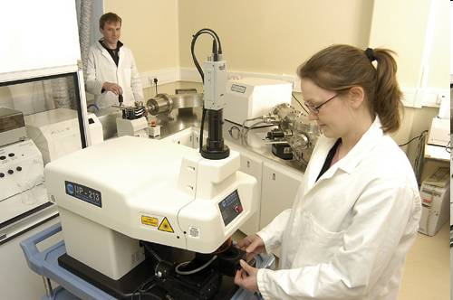
Dedicated MSc Facilities
Three fully equipped teaching laboratories
a network of Unix / PC workstations
45 double screen workstations with both 2D and 3D Schlumberger ™ seismic, well log interpretation and visualisation packages
All industry standard software, including full Petrel suite, Kingdom Suite ™, Roxar RMS
World class research laboratories, including petrophysics, sedimentology labs, ICP, SEM and GIS facilities.

Slide 26
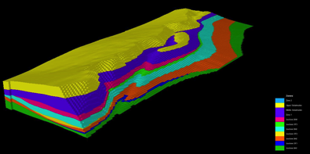
Research Areas
  Carbonate sedimentology and diagenesis
  Digital outcrop analogues and reservoir modelling
  Sedimentology a regional stratigraphy
  Reservoir characterisation
  3D seismic, basin modelling and fluid flow
  Reservoir characterisation and Monitoring using Numerical Simulation
  Marine geology and geophysics
  Landscape evolution and Earth surface processes
  Fluid flow and sediment remobilisation and fault growth
Industrial Consortia
  North Africa Research Group
  STRAT ./ SLOPE Group
  Manchester Shale Gas Research Group
  Carbonate Research Group
Research: Our research incorporates all aspects of the sedimentary basin system, from source to sink and from micro- to macro-scales. Projects integrate structural, sedimentological and geomorphic studies and span the fundamental and petroleum geosciences. We use state-of-the-art acquisition, modelling and interpretation tools on a wide range of datasets.
http://www.seaes.manchester.ac.uk/research/groups/basin/

Slide 27
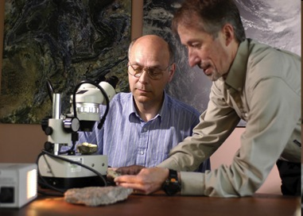
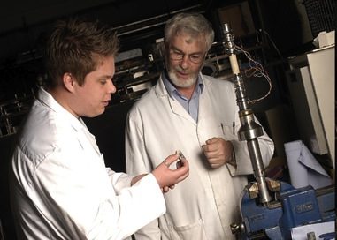
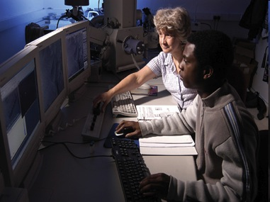
Petroleum Geoscience Teaching
Training includes undergraduate and MSc programmes
Four internationally recognised MSc courses:
  Petroleum Geoscience for Exploration
  Petroleum Geoscience for Reservoir Development and Production
  Pollution and Environmental Control
  Environmental Sciences, Policy and Management (MESPOM)
MPhil/MSc by Research in all research areas.
3-4 year undergraduate training programme in Petroleum Engineering (BEng/MEng).

Slide 28
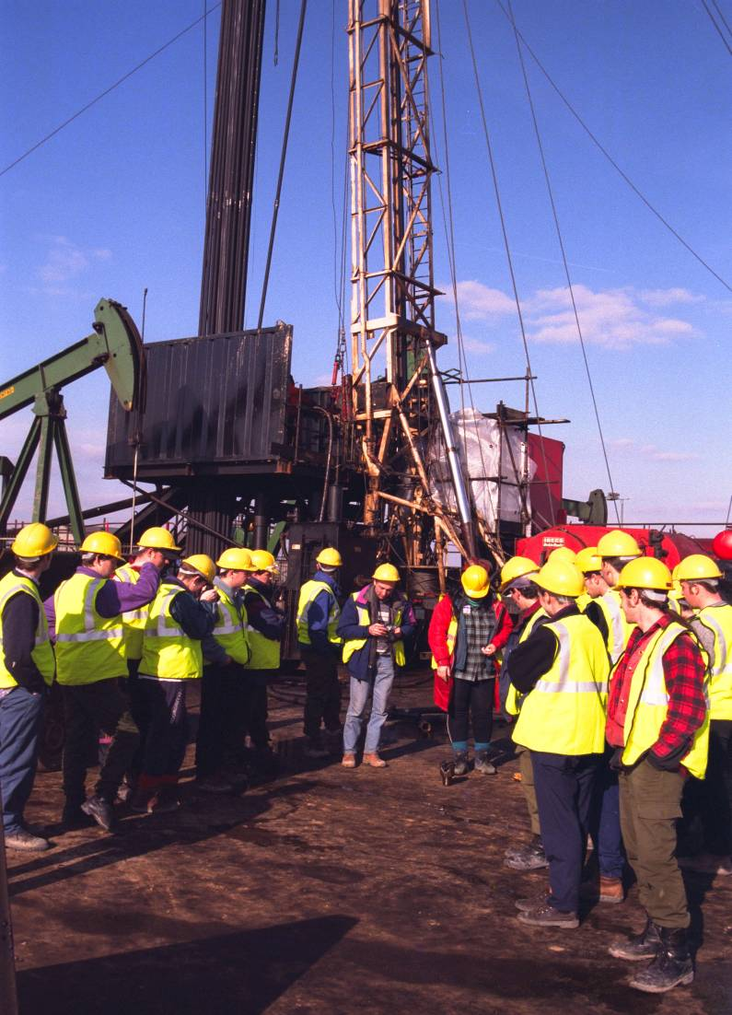
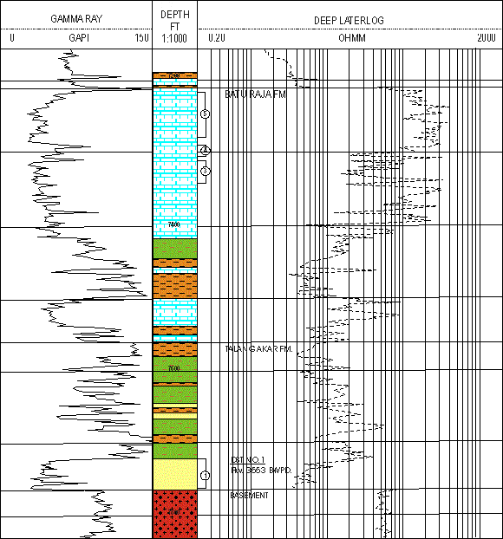
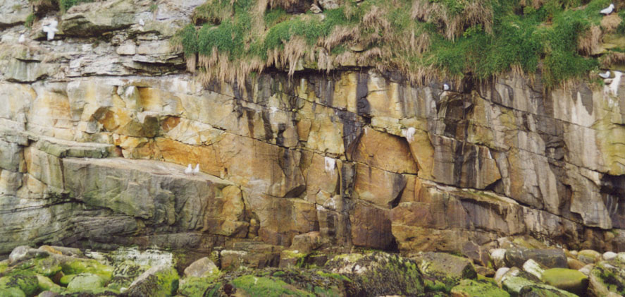
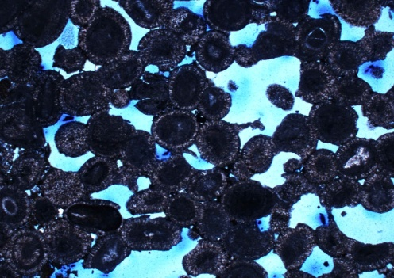
Petroleum Geoscience MSc Courses
The 50 week courses are divided into three stages, Taught Modules 1 and 2 (October to April) comprises lectures and assessed practical /research projects, and a Research Project, from May to September
Taught Module 1: is common to both MScs. Series of introductory courses on the fundamentals of petroleum geoscience, clastic and carbonate reservoir sedimentology, petrophysics, operations and wellsite geology

Slide 29
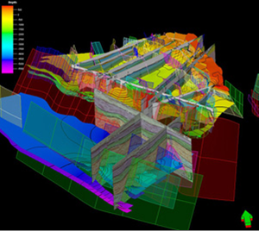
Petroleum Geoscience MSc Courses
Taught Module 2: specialist options, with two pathways:
Petroleum Geoscience Exploration MSc: courses in seismic acquisition, processing & interpretation, basin analysis, sequence stratigraphy, play fairway and prospect evaluation, risk assessment and petroleum economics.
Reservoir Development and Production MSc: focuses on development & production based studies, integrated subsurface analysis, understanding the development plan, advanced reservoir modelling, economics and understanding development strategies.

Slide 30
Petroleum Geoscience MSc
Independent Research Projects
Both MSc courses conclude with an independent research project, where students can specialise
Many students will take the opportunity for industrial placement to complete a project using data provided by a sponsor oil company.
The results are presented as a poster, a written dissertation and orally to a group of invited guests from the oil industry (September each year).

Slide 31
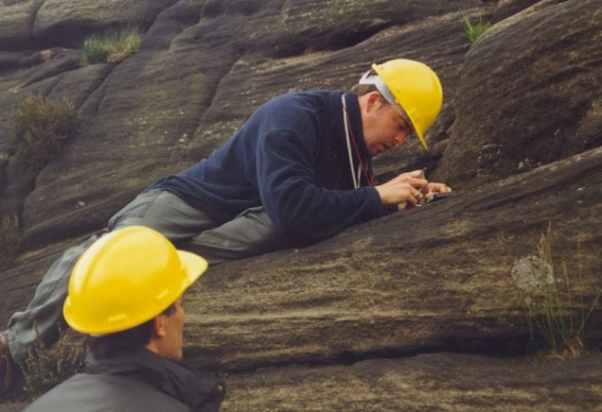
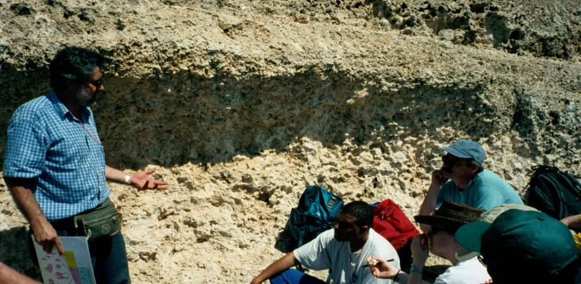
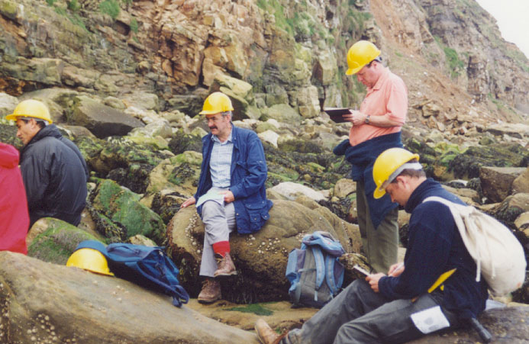
Petroleum Geoscience MSc
Fieldwork
Field courses are vital for the development of observation skills; examination of analogues, visualisation of reservoir architecture and reservoir characterisation.
Two UK-based field courses (reservoir sedimentology and introduction to petroleum systems) and one overseas, either:
Mallorca, Spain, sequence stratigraphy and carbonate sedimentology, or
Ireland: sequence stratigraphy and deepwater & shallow marine clastic systems

Slide 32
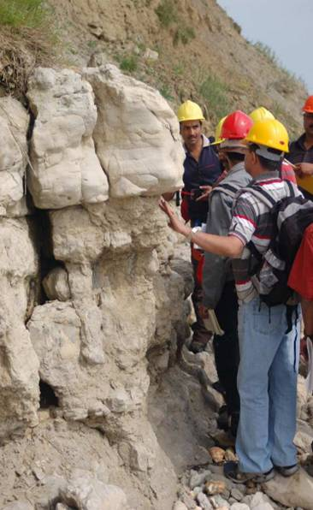
Global class list
Petroleum Geoscience MSc
Overseas students from across the globe: Brunei, Malaysia, India, Saudi Arabia, Nigeria, Gabon, China, Kazakhstan, Trinidad, Russia, Spain, Italy, Libya, Algeria, Egypt, Uganda, and others…….

Slide 33
Petroleum Engineering BEng
Key objective:
To generate technically well-trained petroleum engineers who have a sound knowledge of both engineering and geological aspects of this discipline.

Slide 34
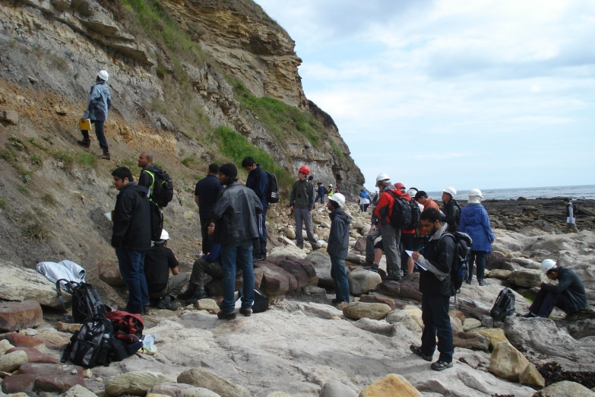
Petroleum Engineering BEng- objectives
Strong geological and engineering core skills
Competence in mathematics
Characterization and evaluation of subsurface geological formations and their resources
Fluid mechanics, strength of materials, and thermodynamics
Design and analysis of systems for producing, injecting, and handling fluids;
Application of reservoir engineering for optimizing resource development and management
Use of project economics and resource valuation methods for design and decision making
Development of cores skills , rigorous academic standards, problem based learning, practical courses and fieldwork

Slide 35
Curriculum
YEAR 1
Engineering Maths for Pet Eng
Engineering Thermodynamics for Pet Eng
Transport Phenomena for Pet Eng
Information Technology
Sedimentology for Petroleum Engineers
Fundamentals of Petroleum Engineering
Earth Science Tutorials
Liverpool Bay Case Study
Introduction to Petrophysical Techniques
YEAR 2
Process design and simulation
Mathematical methods II
Chemical thermodynamics
Solid fluid systems
Momentum, heat and mass transfer
Petroleum Engineering Lab project
Drilling and well testing
Advanced Petrophysical techniques
Geophysics for petroleum engineers
Geostatistics and reservoir modelling
Depositional systems project
YEAR 3
Process Fluid dynamics
Oil and gas processing
Reservoir performance
Petroleum engineering design project
Energy resources and HSE
Advanced reservoir modelling
Subsurface data analysis
Fieldwork II
Carbonate reservoir sedimentology
Structural geology and geomechanics
Lectures, problem based learning, practical courses, fieldwork and tutorials to generate petroleum engineers who have strong core geological and engineering skills.
YEAR 4
Independent Research Project
Fieldwork/communication skills
4 elective modules, project related
Course hosted by SEAES, joint degree with CEAS

Slide 36















Funding / Sponsorship
Funding and research links are established with the global oil industry. Some examples of recent research and MSc/undergrad funding includes:
  AGOCO, Hess, BG Group
  BP, Exxon
  Pakistan Petroleum
  Petrocanada, PTDF
  Repsol, Shell
  Sirte Oil, Waha
  Wintershall, Saudi Aramco
  PDO

Slide 37
How might UK universities help?
Petroleum-related M.Sc courses provide a very efficient one year introduction to many upstream skills
  Funding from oil companies or British Council
University to University Collaboration
  Joint research projects with PhD students
  Assistance with setting up in Sri Lanka:
    Undergraduate modules in petroleum-related skills
    Post-graduate petroleum-related courses feeding into international M.Sc or oil company secondment

