Slide 1
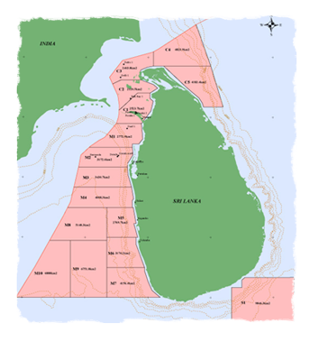
Capacity Building Needs in Oil and Gas Industry
Competency Building and Capacity Enhancement in the Emerging Oil and Gas Industry in Sri Lanka
Eng. Mangala P. B. Yapa
MD/CEO Colombo Dockyard PLC

Slide 2
O&G Industry Classification as per American Petroleum Industry (API)
Upstream sector
Downstream sector
Marine sector
Pipeline sector
Service and supply sector

Slide 3
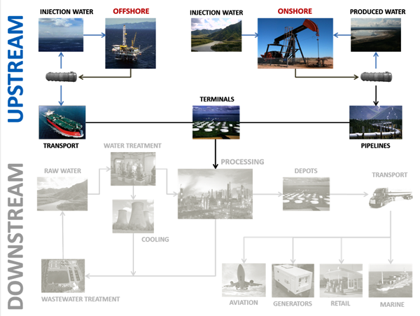
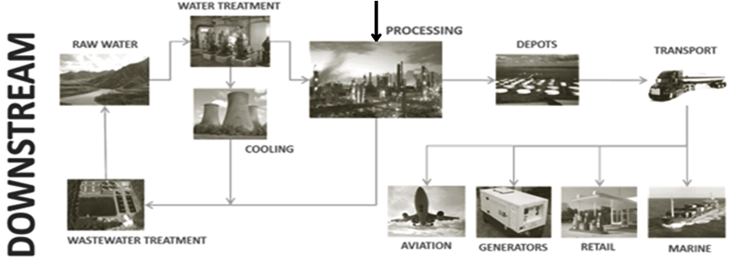
EXTENT of Oil and Gas Industry

Slide 4
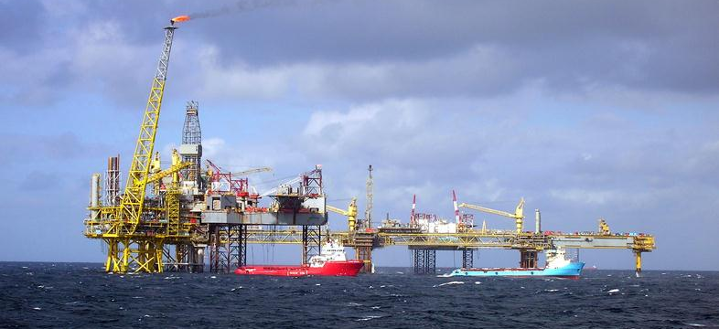
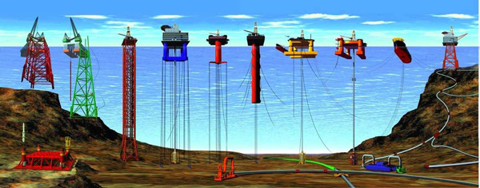
Marine sector

Slide 5
Exploration & Production
Onshore Offshore Natural Gas Oil Sands Oil Shale Hydraulic Fracturing
Transportation
Oil Tankers Pipelines Pipeline Performance Tracking System
Refining
Gasoline Diesel Heating Oil Engine Oil
Consumer
Use Energy Safely Use Energy Wisely

Slide 6
Activities in the Upstream Sector Value Chain
Greenfield
Brownfield
Exploration Phase
Development Phase
Production Phase
Abandonment Phase
Seismic activities
Drilling services
Marine support
Engineering and project management
Hook-up and commissioning
Drilling rigs and services
Construction and fabrication of structures
Marine support
FPSOs supply and operation
ROVs supply and operation
Operations and maintenance services
(Field review and optimisation)
Retrofit work
Structural maintenance and upgrade
Equipment maintenance and upgrade
Marine support
FPSOs supply and operation
ROVs supply and operation
Well plugging
Dismantling of structures
Decommission machinery and equipment
Marine support
Source: Complied by Frost & Sullivan

Slide 7
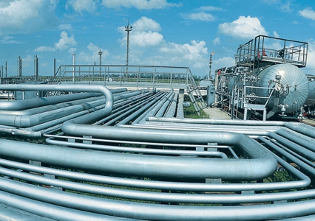
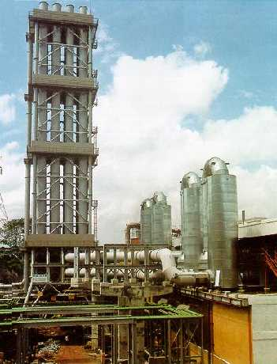
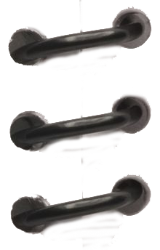
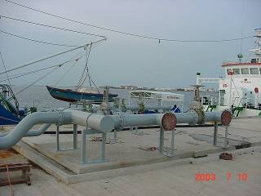
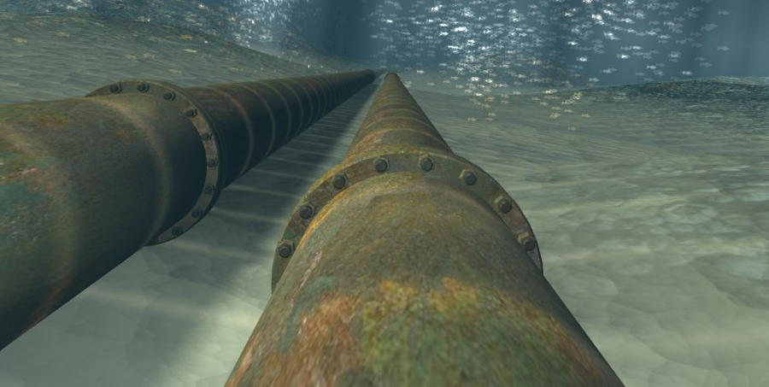
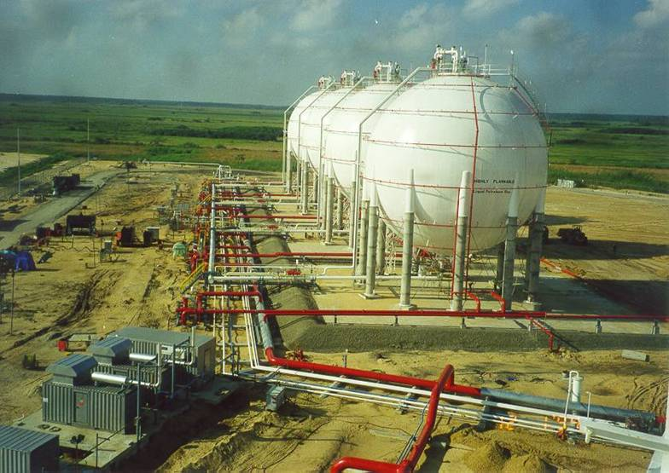
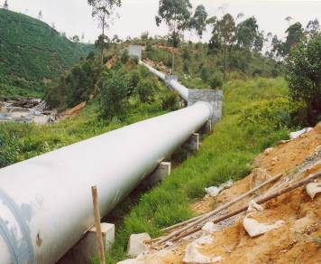
Pipeline Sector of Oil and Gas Industry
Industry Need
Local Strength
Multiflue Chimney for Power Generation
in 1998
FO Storage for100MW Thermal Power Plant Project I
in 2004
Harbour Berth Extension Funadhoo Male
In 2003
Hapugastenne
Canyon Penstock Pipeline
in 2001
LPG Spheres for
Shell Terminal Lanka
In 1999

Slide 8
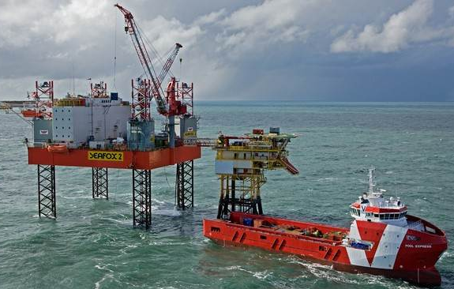
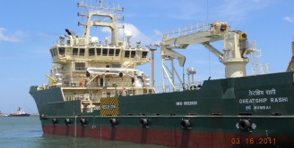
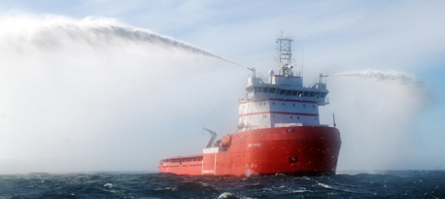
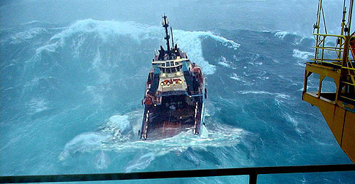
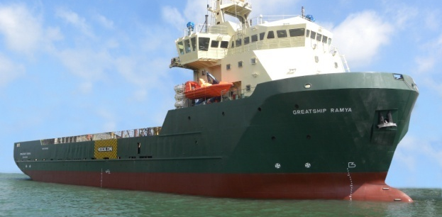
Service and Supply Sector
Industry Need
Local Strength
AHTSV
ROV MPSV
MPSV

Slide 9
Towards Enhanced Local Content in Oil and Gas Industry in SL
Certain strengths, especially in the Marine Sector, is already available.
Integrated Competency Building through prudent vocational training is underscored.
Further CAPACITY ENHANCEMENT in identified areas is vital.
Gap identification between LOCAL POTENTIAL and INDUSTRY NEEDS must be done.
Greater participation of ALL STAKEHOLDERS adopting prudent strategies is vital.
Both the PUBLIC and PRIVATE Sectors have to work in tandem keeping national interests in the fore.

Slide 10
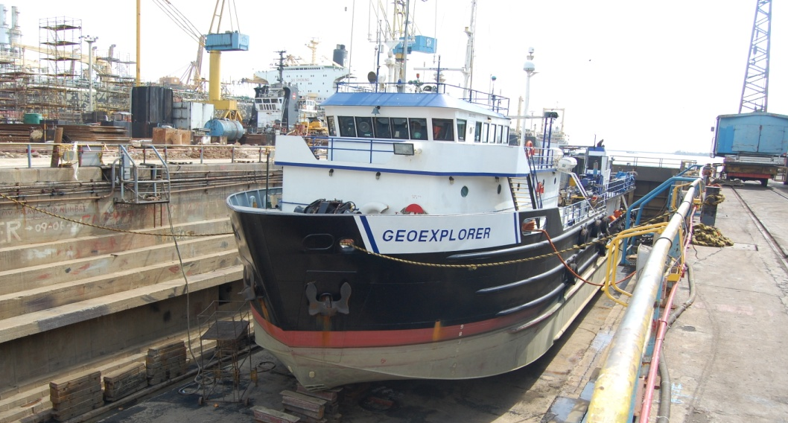
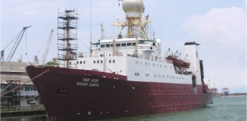
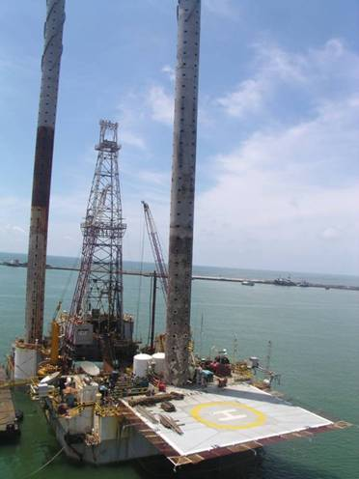
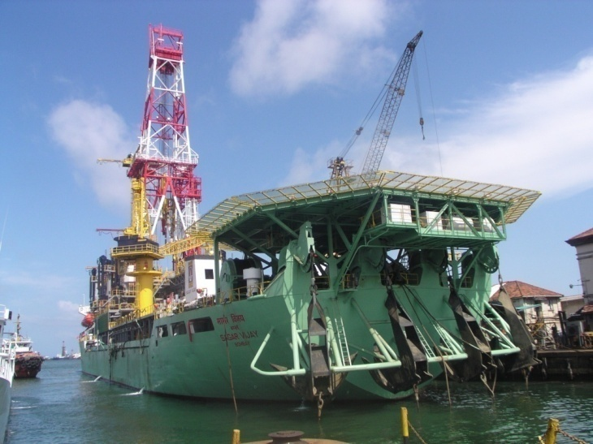
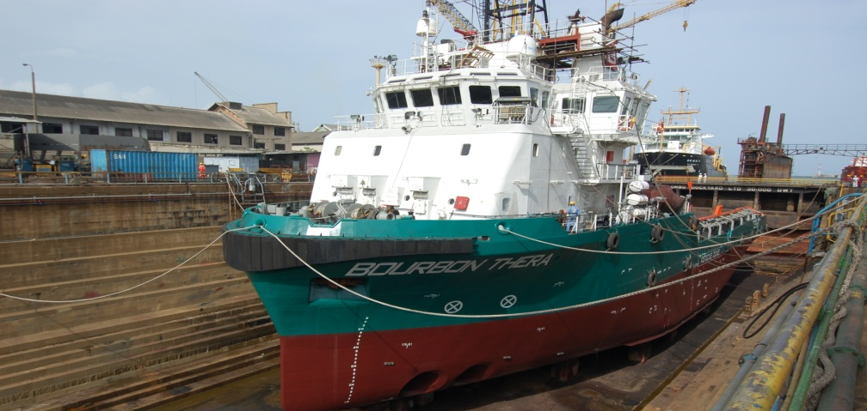
SWOT for Marine Sector Participation in the O&G Sector of SL
By Sri Lankan Entities
Own / Chartering
Highly Possible
Repairing
Building
Highly Possible
Husbanding

Seismic
activities
Seismic Vessel
Drilling
services
Rigs
Partially Possible

Possible
Drilling Ship
Remotely Possible
Partially Possible

Marine
support
Anchor Handling Tugs
Extremely Possible

RO Vessel
Extremely Possible

MPS Vessel
Extremely Possible


